Slide 1



Workshop 5
RECI Thementag 2021 – Journée thématique du RECI 2021
16.11.2021
Moumouni Magawata & Alexander Kappeler
- speakers
Arabela Philipona - speaker
Reconnaître le rôle de l’éducation dans la prévention des maladies et le support des activités EHA aux écoles
Rolle der Bildung in der Vorbeugung von Krankheiten und Unterstützung von Wash-Aktivitäten an Schulen:
Moderated by Denis Hofer from

Slide 2
Table des matières I Inhaltsverzeichnis
Résumé I Zusammenfassung
(SLIDE 3)
POWERPOINT HELVETAS
(SLIDE 4)
PHOTOS I FOTOS
(SLIDE 54)
VISUELLE ZUSAMMENFASSUNGEN I RÉSUMÉS VISUELS
(SLIDE 58)
QUESTIONS DE CONCLUSION I ABSCHLIESSENDE FRAGEN
(SLIDE 52)
POWERPOINT CARITAS & SWISS WATER AND SANITATION CONSORTIUM
(SLIDE 13)

Slide 3
Résumé I Zusammenfassung
L'atelier 5 comprend une présentation de l'approche Blue Schools, avec deux exemples au Cambodge et au Niger. Avec l’approche « Ecoles Bleues » on assure aux élèves la disponibilité en eau propre, des latrines fonctionnelles et bien entretenues et une alimentation adéquate. Les intervenant·es d'Helvetas et du Swiss Water and Sanitation Consortium se sont concentrés sur les expériences et les défis rencontrés dans la mise en œuvre de l'approche pendant la pandémie. Les participant·e·s essont engagé activement à la discussion et ont partagé les leçons apprises et les idées concrètes pour les intégrer dans leur propre travail. Ils ont eu également l'occasion d'apporter leurs propres expériences et connaissances pratiques. À la fin de l'atelier, nous avons receuilli les idées et les points d'apprentissage pour renforcer les activités de santé, de prévention de l'hygiène et de WASH dans les écoles.
In Workshop 5 umfasste der Blue School Approach anhand von zwei konkreten Beispielen aus Kambodscha und Niger. Mit dem Blue School Approach wird sichergestellt, dass die Kinder Zugang zu sauberem Wasser, funktionierenden und gut gewarteten Latrinen und einer angemessenen Ernährung haben. Die Referierenden von Helvetas und dem Swiss Water and Sanitation Consortium konzentrierten sich auf die Erfahrungen und Herausforderungen, die während der Pandemie bei der Umsetzung des Ansatzes aufgetreten sind. Die Teilnehmenden beteiligten aktiv in die Diskussion und teilten sich über ihre gewonnenen Erkenntnisse und konkreten Ideen zur Umsetzung in ihrer eigenen Arbeit aus. Sie hatten auch die Möglichkeit, ihre eigenen Erfahrungen und ihr Praxiswissen einzubringen. Am Ende des Workshops erhielten wir gewonnene Erkenntnisse, um Gesundheits, Hygiene- und WASH-Aktivitäten an Schulen zu stärken.

Slide 4

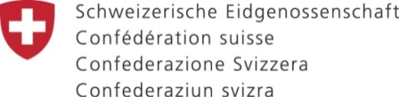
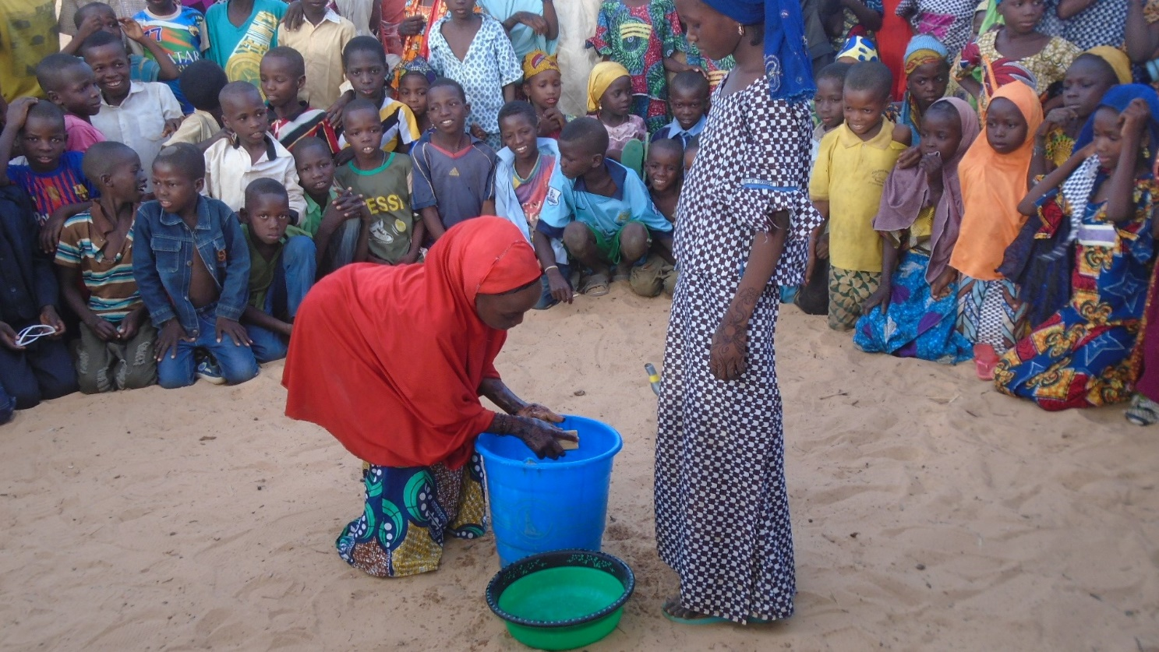

Programme Hydraulique Rurale, Appui au Secteur Eau et Assainissement (PHRASEA)
Les interventions du PHRASEA renforcent la lutte contre le Covid 19 en milieu scolaire
Moumouni Magawata
10 novembre 2021

Slide 5
Aspects généraux
En 2020, le consortium Helvetas - HEKS a obtenu des fonds spéciaux de la DDC, pour des actions spécifiques de lutte contre le Covid 19,
Ces actions ont complété les Actions du PHRASEA pour assurer aux populations l’accès universel et équitable à l’eau potable, et à des services d’assainissement et d’hygiène adéquats.
(3 Régions : Maradi, Dosso et Tillabéri pour l’hydraulique pastorale)

Slide 6
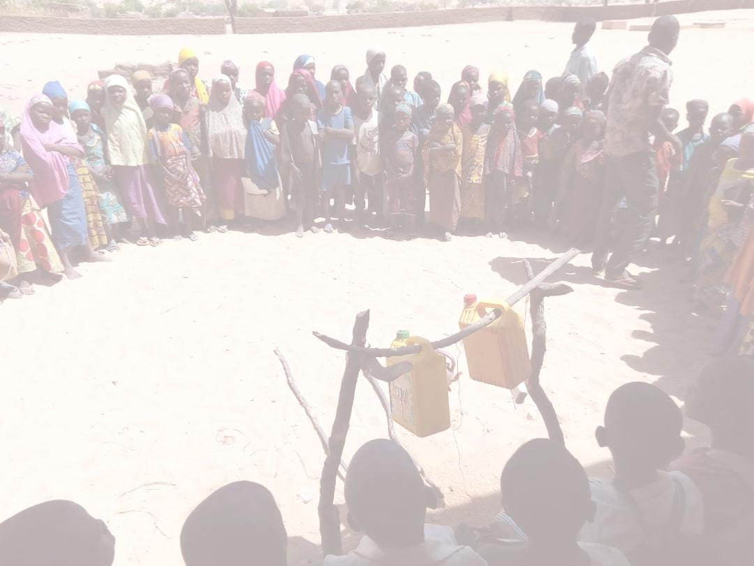
Groupes cibles
Communautés villageoises
Elèves
Centres de santé
Communautés pastorales
Stratégie du programme
Basée sur le approche inclusive du Wash
Milieu villageois
Etablissements scolaires
Centres de Santé

Slide 7
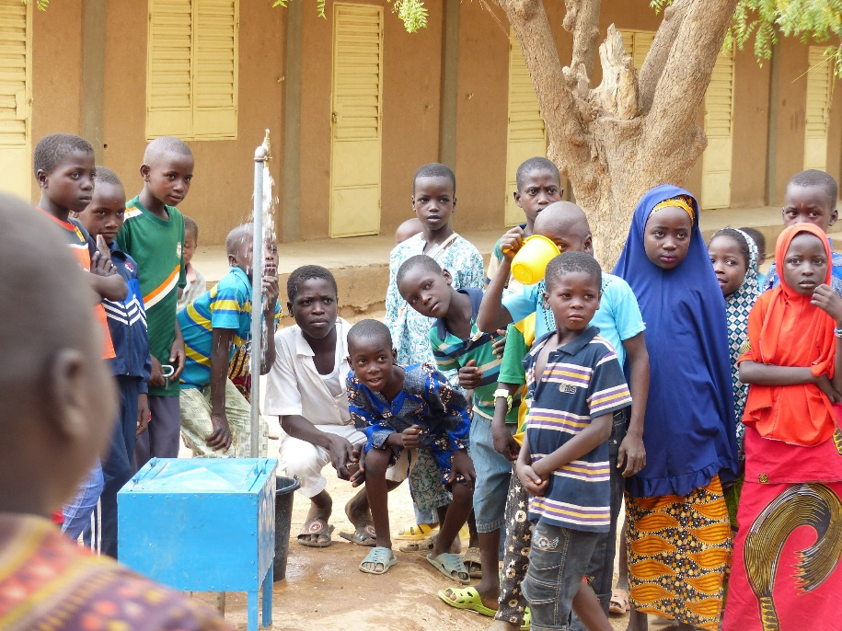
De l’eau potable à l’école pour lutter contre le Covid
Le branchement systématique de tous les établissements scolaires au réseau d’adduction potable contribue à la prévention du Covid 19
Sensibilisation des élèves sur les thèmes comme :
Les bonnes pratiques en matière d’hygiène
Le lavage des mains au savon (avantages et moments critiques)
Les gestes barrières

Slide 8
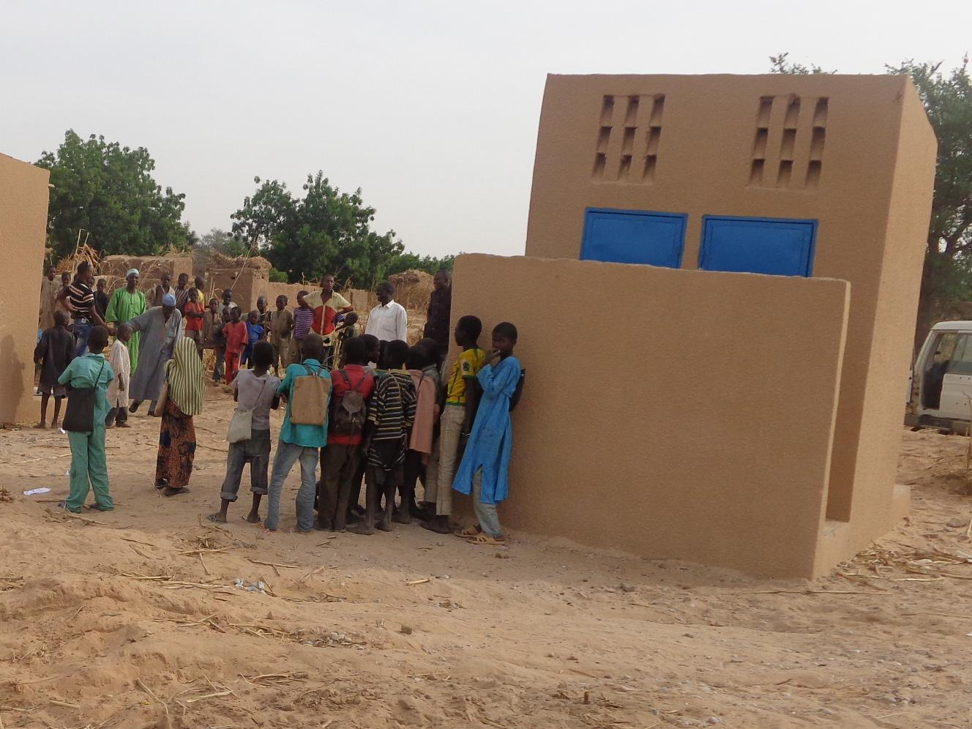
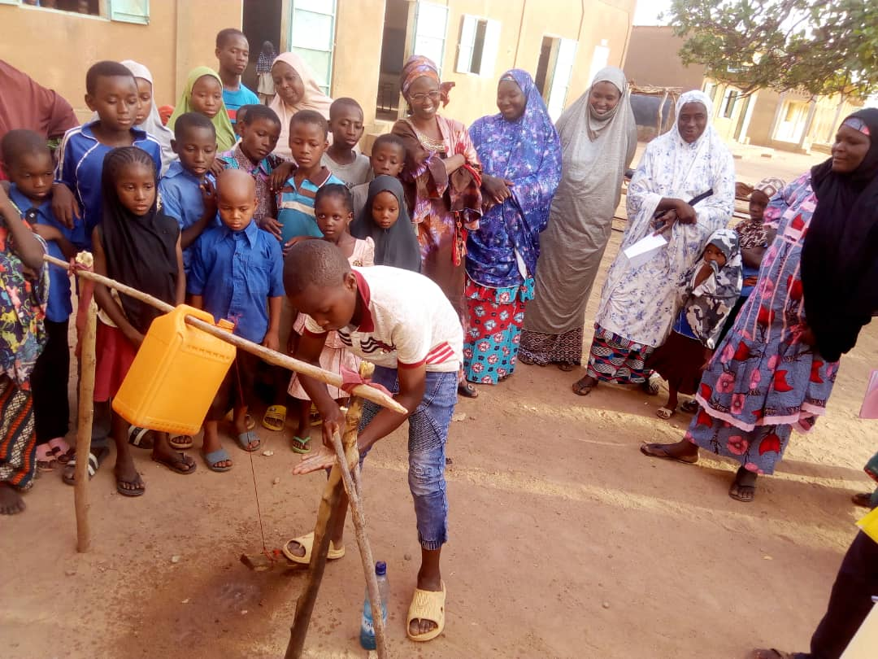
Des latrines scolaires mieux adaptées à la prévention
3 blocs de cabines bien séparés
Bloc filles
Bloc garçons
Blocs enseignants
Installation des dispositifs de lavage des mains au savon
Installation des Tippy Tapp (pour le lavage des mains)
Mise en place des Comités scolaires d’entretien des latrines

Slide 9
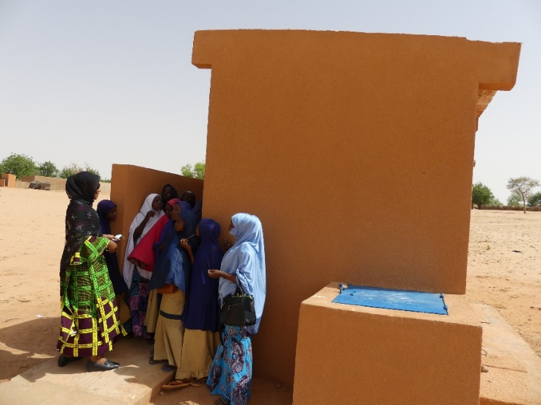
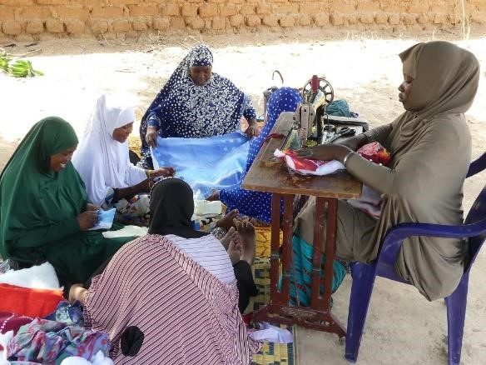
La gestion de l’hygiène menstruelle à l’école participe à la prévention
Constats
Manque de latrines adaptées à la GHM
Les filles perdent 5 jours / mois du fait de leurs règles
Certaines filles abandonnent
Qu’avons-nous fait ?
Le PHRASEA a été un des premiers à réaliser des latrines adaptées (eau, produits d’entretien, gestion des serviettes usagées)
Renforcement des connaissances sur la puberté
Des femmes couturières locales formées et équipées pour confectionner des serviettes hygiéniques
Les élèves s’organisent pour assurer l’entretien de leurs latrines

Slide 10
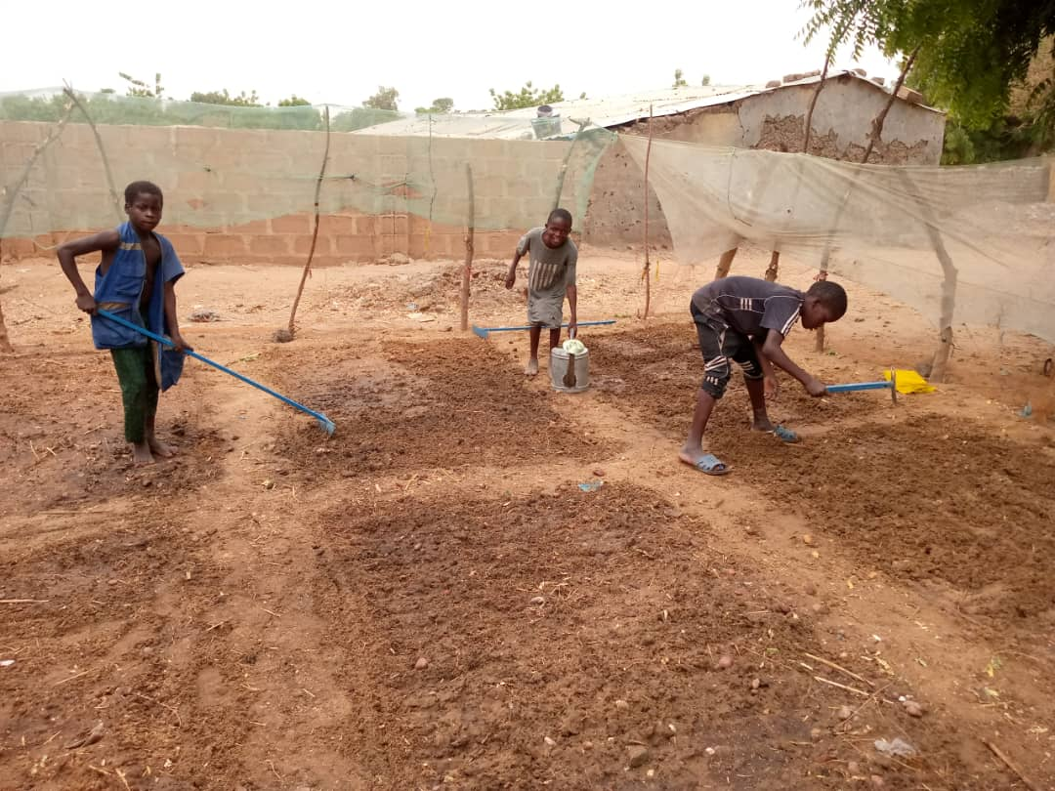
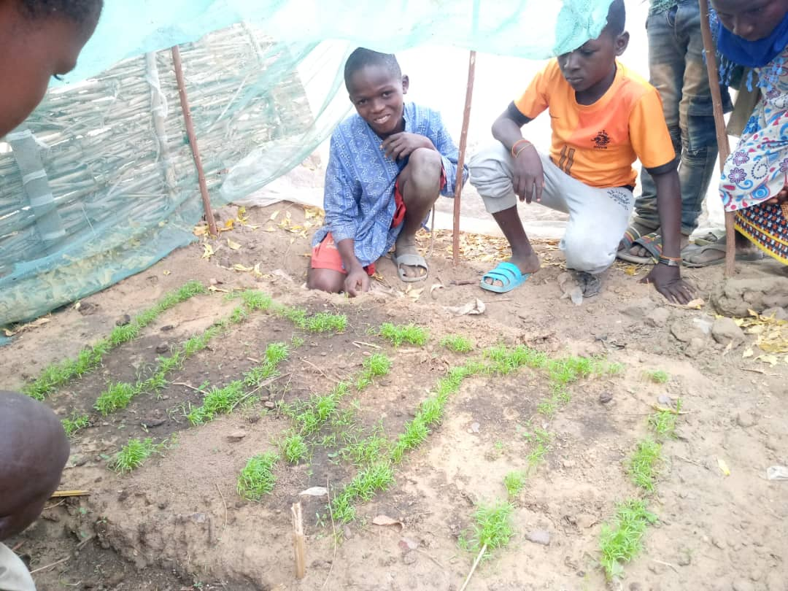
Une bonne alimentation participe aussi à la prévention !
Les écoles Bleues : Objectifs pédagogiques
Améliorer la qualité de l’alimentation
Faire prendre conscience aux élèves que l’eau est une ressource limitée, qu’il est important de protéger et de bien utiliser
Inciter les élèves à protéger leur environnement, et à devenir agents de changement dans leur communauté

Slide 11

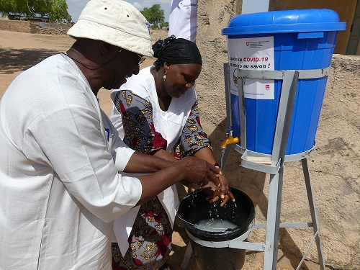
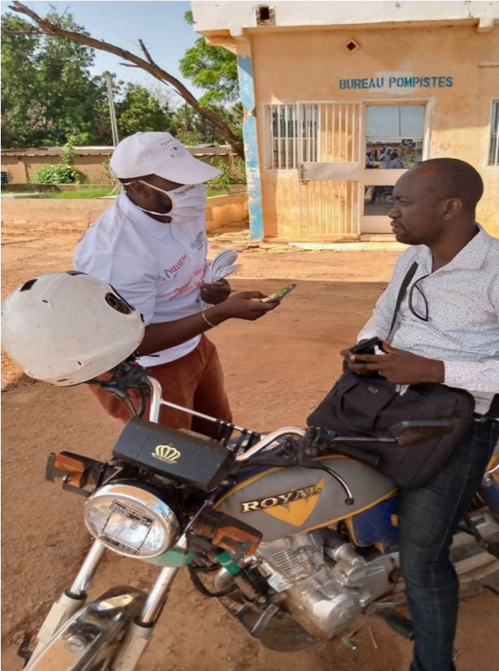
Au-delà des écoliers d’autres acteurs s’impliquent dans la lutte
Les autorités participent aux actions de prévention
Une enquête auprès des jeunes la perception du Covid 19
connaissance de la maladie, leur implication dans la prévention, l’application des gestes barrières, l’impact sur les revenus des jeunes
Participation à la 7ème Journée de l'étudiant en sociologie et anthropologie
sensibilisation des étudiants sur la maladie en lien avec les dynamiques sociales, impactées par le Coronavirus

Slide 12
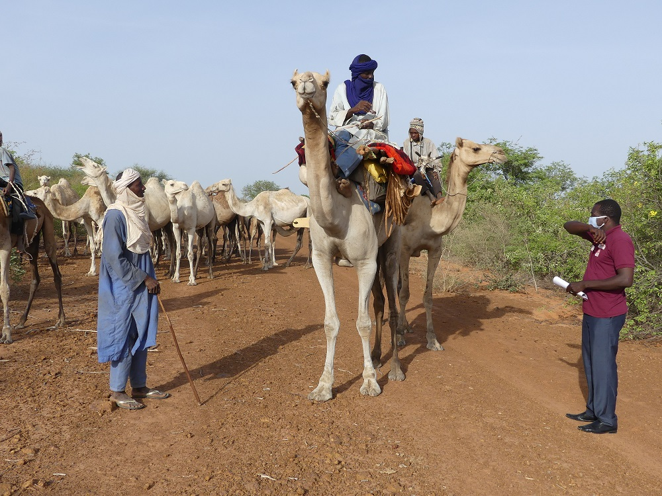
La prévention aussi en milieu nomade…
Merci de votre attention.

Slide 13
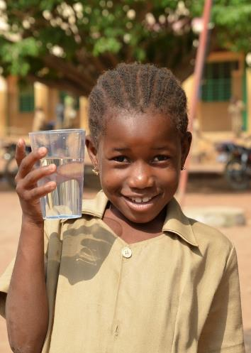

Blue Schools
Infosession
Oct/Nov 2020
Ramesh Bohara – RA Asia
Lucie Leclert – RA East Africa

Slide 14
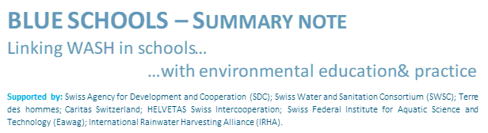
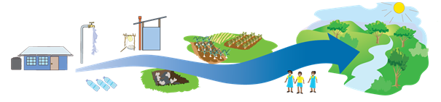
What is a Blue School?
A Blue School is the school where children learn hands-on about hygiene and environmental conservation. It offers a healthy learning environment and exposes students to environmentally friendly technologies and practices that can be replicated in their communities.
Becoming a Blue School is a step by step process. The starting point is to ensure that children drink safe water, use well-maintained latrines and maintain good hygiene practices.
Once this is achieved, Blue Schools goes beyond WASH and focuses on menstrual hygiene and health, gardening activities, safe management of solid waste, and environmentally friendly practices. Children learn about these topics through practice and experiments.

Slide 15
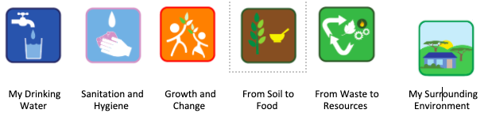
What is the Blue Schools Kit?
Components of the Blue Schools Kit:
Catalogue of Technologies: Examples of low-cost, easy to replicate technologies to choose from
Catalogue of Practical Exercises: Hands-on and low-cost participative activities that teachers can use to complement the theoretical lessons
Facilitator’s Guide: A visual summary of the practical exercises that a teacher can use for each Blue Schools topic
These materials are meant to inspire school stakeholders on their pathway towards becoming a Blue School. They are organised in different topics:
WASH-related topics: safe drinking water, sanitation and hygiene, menstrual health and hygiene;
Environment-related topics: Sustainable land and water management techniques to apply in gardening activities, safe solid waste management, watershed, water cycle, etc.

Slide 16
Blue Schools and the SWSC
The ideas behind Blue Schools are not new. The Blue Schools Kit was developed in 2018 by the Swiss Water and Sanitation Consortium (SWSC) project teams and advisors from HELVETAS, Caritas Switzerland and Terre des hommes, in collaboration with Eawag based on field experience in WASH in Schools and lessons from piloting the environmental components in schools. Between 2020 and 2023, SWSC implements Blue Schools in over 150 schools in 12 countries. In addition, several other organisations are using the Blue Schools Kit in various countries.
The Blue Schools Kit is freely accessible online: http://waterconsortium.ch/blueschool
For more information, please contact:
Moumouni Magawata (Helvetas) moumouni.magawata@helvetas.org
Arabela Philipona (Caritas Switzerland) aphilipona@caritas.ch

Slide 17
Objective of the infosession
→ This is not a training of trainers. Just an infosession to get clearer on the next steps
Objective of session 1
Common understanding of the Blue Schools Approach.
Sharing lessons learned.
Getting familiar with the materials of the Blue Schools Kit.
Defining the main phases for our Blue Schools road map.

Slide 18
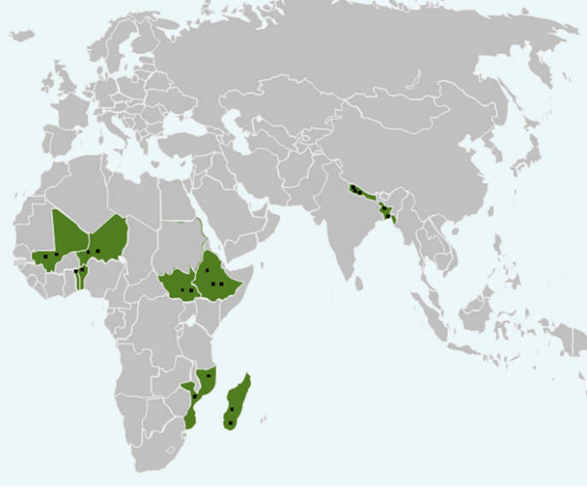
How was the Blue Schools Kit developed?
Blue Schools approach versus Blue Schools Kit
The Blue Schools approach is not new!
One note from SDC existed but overall goal and principles not fully clear.
Through the SWSC, the Blue Schools Approach was piloted in 7 countries between 2011 and 2017.
BUT different understanding on Blue Schools

Slide 19
How was the Blue Schools Kit developed?
→ Advisors from different organisations came together and concluded that there is a need:
To clarify the purpose of a Blue School
To agree on the components/topics of a Blue School
To come up with clear indicators that defines a Blue School
For inspiration on activities linked to environment
For more guidance on how to implement Blue Schools
To get advice on how to ensure stakeholders ownership and sustainability.
→ Rationale to develop the Blue Schools Kit

Slide 20
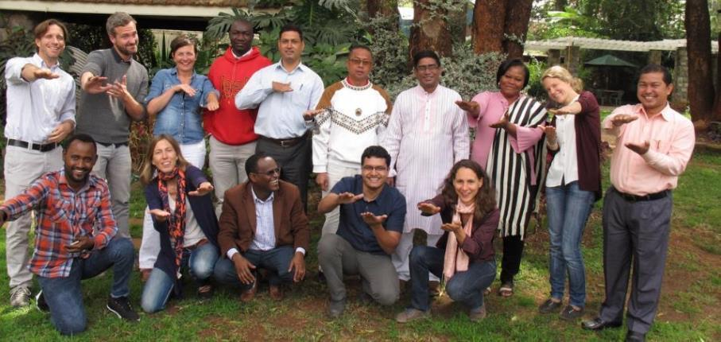
How was the Blue Schools Kit developed?
Blue Schools workshop organized in July 2017 in Nairobi to get feedback from project teams.
Advisors from various organizations + resources persons (EAWAG + IRHA) worked on materials.
Blue Schools Kit launched in Stockholm World Water Week in September 2018.

Slide 21
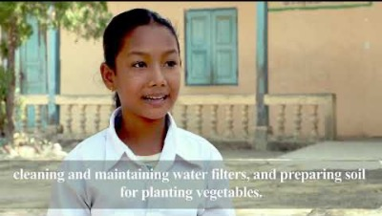
What is a Blue School?

Slide 22










What is a Blue School?
→ A healthy and environmentally friendly school….. Where:
ALL Students at the centre
Use safe drinking water and well-maintained latrines.
Maintain good hygiene practices (including MHM).
Take part in gardening activities.
Participate in solid waste management.
Take part in environmentally-friendly activities.
→ Replicate good practices to Parents
ALL Teachers
Complement theoretical classes with practical exercises.
Need to put in place an enabling environment for children to practice!
→ Learning by doing as a key concept !!

Slide 23
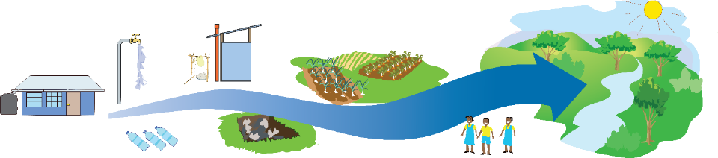
What is a Blue School?
Becoming a Blue School is a pathway (step by step).
WASH requirements to be addressed first (Especially in COVID-19 times).
Each school and context is different.
→ Any School that is on this pathway can be called a Blue School.
Final destination:
Health and Environment

Slide 24
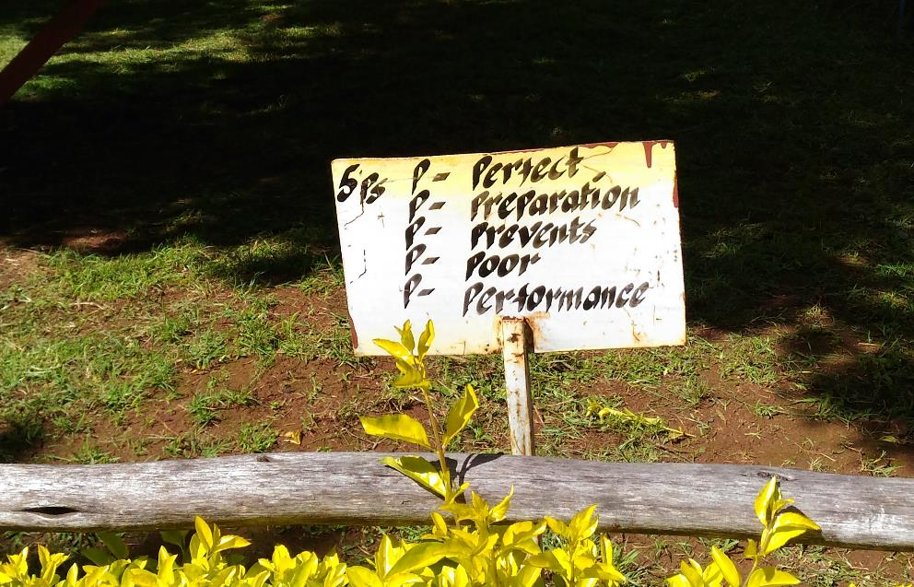
Lessons learned – Phase 2

Slide 25
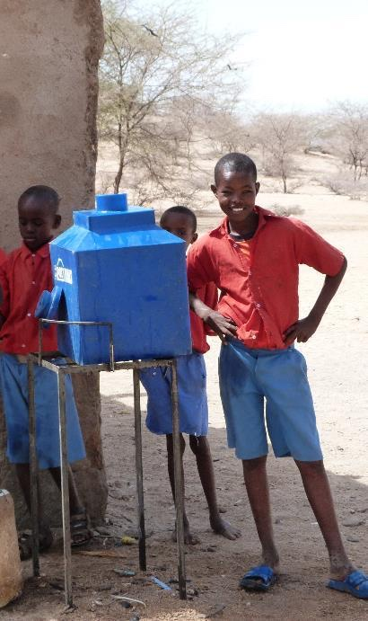
What to keep in mind…
Blue Schools is about:
Hardware
Catalogue of Technologies
Children’s engagement
Catalogue of Practical Exercises
+ Facilitators Guide
Each school is different!

Slide 26
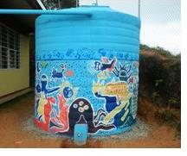
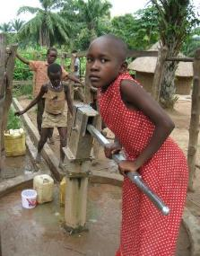
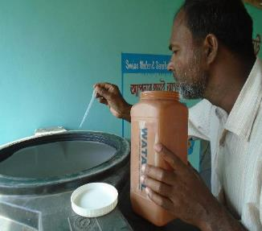
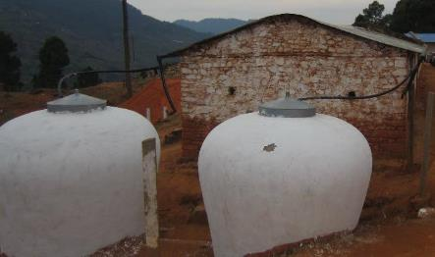
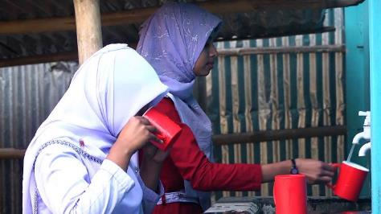
Access to drinking water - Services
IRHA, Mexico
South Sudan
Caritas Switzerland, Bangladesh
Having access to an improved water source is the starting point.
The best technical solution depend on the context.
Helvetas, Nepal
TdH, Bangladesh
Notes:
Rain water collection (IRHA)
Low External Input Sustainable Agriculture (Terre des hommes)

Slide 27
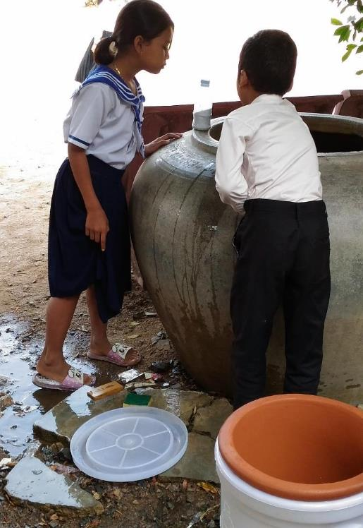
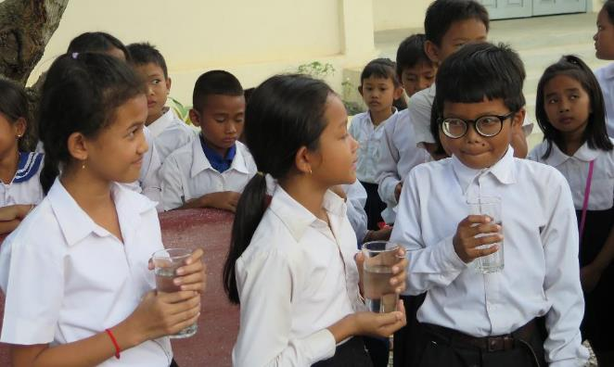
Access to drinking water - Practices
Learning by doing: the importance to drink safe water and how to keep it safe.
Caritas Switzerland, Cambodia

Slide 28
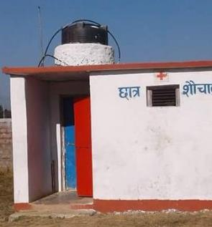
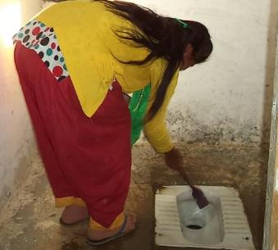
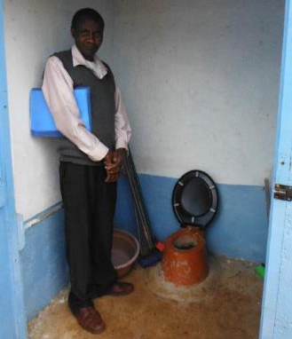
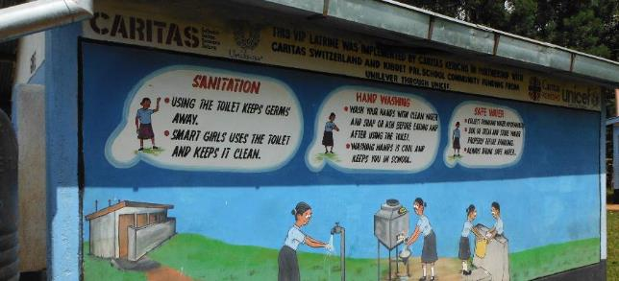
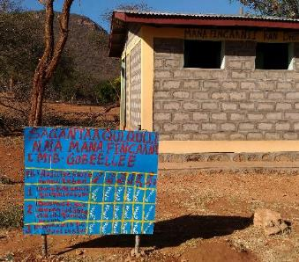
Sanitation and hygiene - Services
SRC, Nepal
Caritas Switzerland, Kenya
Helvetas, Nepal
Access to improved sanitation facilities is key. AS WELL AS HANDWASHING FACILITY + SOAP
Importance to align with national designs and guidelines.
Caritas Switzerland, Kenya
Caritas Switzerland, Ethiopia
Notes:
Rain water collection (IRHA)
Low External Input Sustainable Agriculture (Terre des hommes)

Slide 29
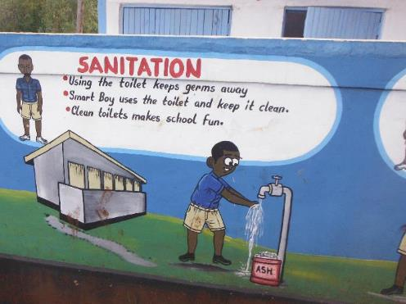
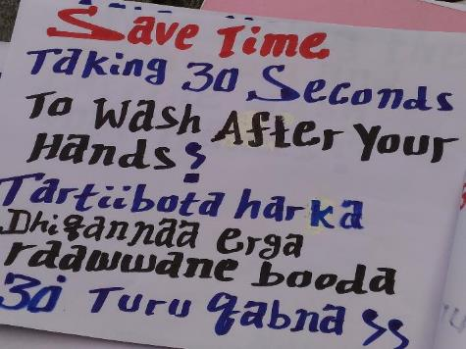
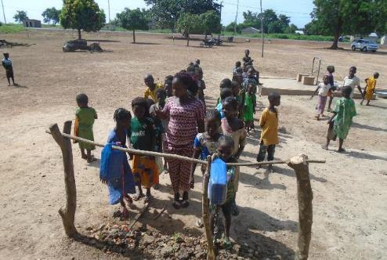
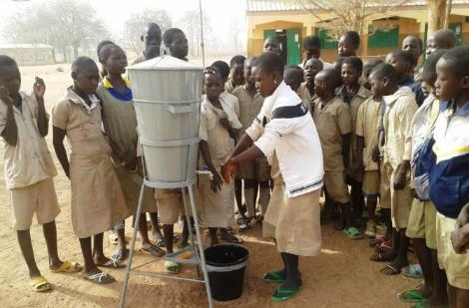
Sanitation and hygiene - Practices
Caritas Switzerland, Kenya
Caritas Switzerland, Ethiopia
To go from awareness raising to behavior change, it is important to create an enabling environment and to institutionalize good practices.
Helvetas, Benin
Helvetas, Benin
Notes:
Rain water collection (IRHA)
Low External Input Sustainable Agriculture (Terre des hommes)

Slide 30
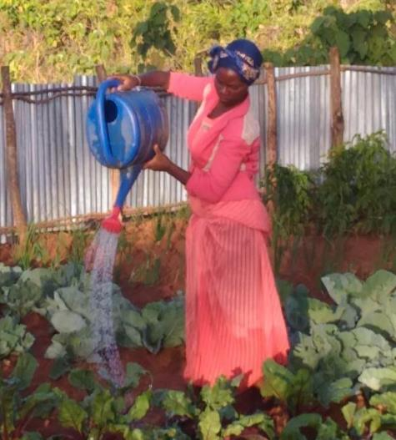
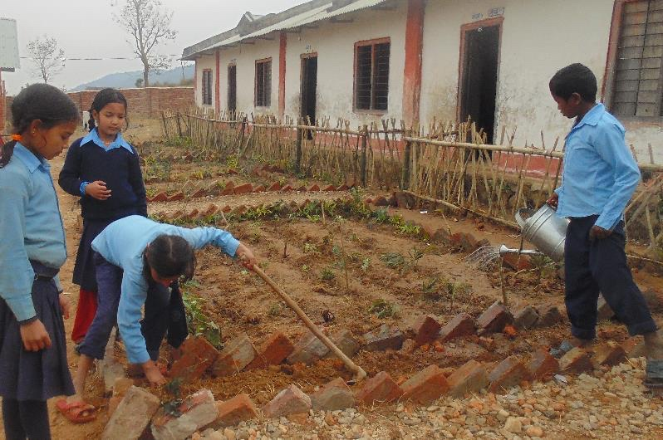
School garden – the garden
Caritas Switzerland, Ethiopia
SRC, Nepal
Access to water is key before initiating a school garden.

Slide 31
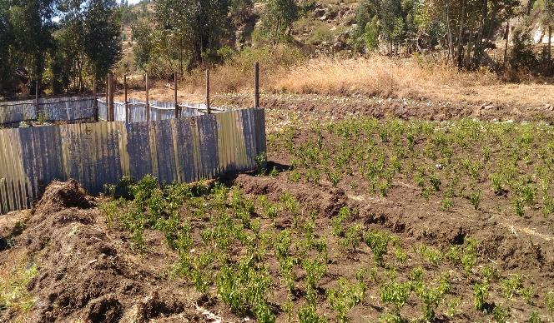
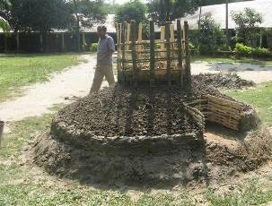
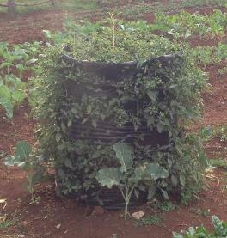
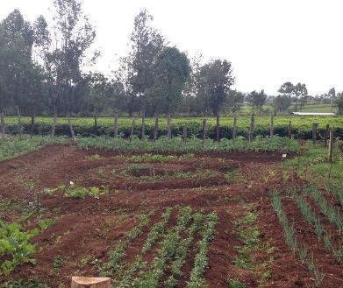
School garden – the garden
TdH, Bangladesh
Caritas Switzerland, Kenya and Ethiopia
Access to land and space is also a factor to consider! A school garden does not need to be big.

Slide 32
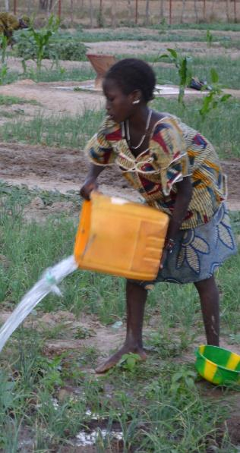
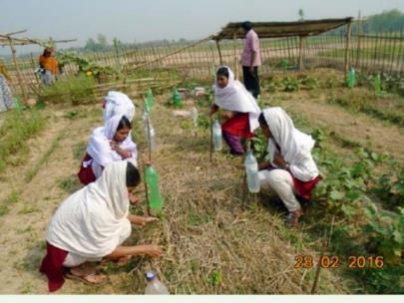
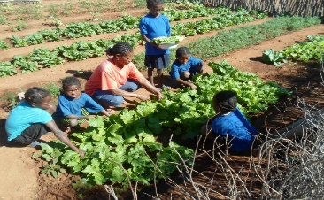
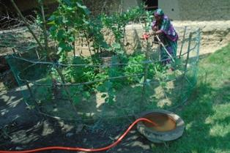
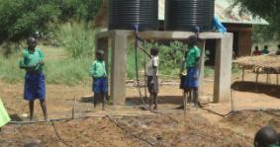
School garden – Practices
Caritas Switzerland, Bangladesh
Fastenopfer, Madagascar
A school garden is a good place to pilot innovative and good land management practices.
Need for clear arrangements for the school garden: What? Who? When? How?
Caritas Switzerland, Ethiopia
Caritas Switzerland, Bangladesh
Caritas Switzerland, South Sudan

Slide 33



Menstrual Hygiene Management
SRC, Nepal
The first step is to change teachers and boys’mind and breaking the taboos!
There is a need for enabling environment.

Slide 34



Solid Waste Management
EAWAG, Peru
Caritas Switzerland, Kenya
SRC, Nepal
Insfrastructure and services need to be there… but safe management of solid waste is more than that!
Think 3R: Reduce, Reuse, Recycle (and above all, NOT BURNING PLASTIC WASTE!).

Slide 35







Solid Waste Management
Recycling
Caritas Switzerland, Cambodia
Caritas Switzerland, Cambodia

Slide 36

Solid Waste Management
Reusing
Caritas Switzerland, Cambodia

Slide 37




Solid Waste Management
Before
After
Reducing
Before
After discussion between school administration, parents and school vendors
Caritas - Cambodia

Slide 38



Solid Waste Management – Learning and practice
Caritas Switzerland, Cambodia
When it comes to waste, it is not only about children not practicing, but also lack of knowledge on why and how to deal well with waste.
Caritas Switzerland, Bangladesh

Slide 39


Environment
Planting trees can be a starting point… but what is key in any activity is the discussion and learning around this topic. ‘Why are trees important?’
Caritas Switzerland, Kenya
Fastenopfer, Madagascar

Slide 40



Environment
Practices are context specific and needs to be discussed with school stakeholders.
They can be in the school environment or in the surrounding community.
Helvetas, Nepal
3 R in environment (Rentention, Recharge, Reuse of water) for biodiversity and water conservation
Helvetas, Nepal
Notes:
Stabilisation des sols contre l’erosion avec l’horticulture et les canaux d’infiltration, plantation des arbres (Helvetas)

Slide 41

What is the Blue Schools Kit?

Slide 42

What is the Blue Schools Kit?
Support and inspiration materials for schools stakeholders
Four documents:
A Concept Brief
A Catalogue of Technologies
A Catalogue of Practical Exercises
A Facilitator’s Guide
Why catalogues?
To inpire, not to impose. To enrich lessons, not to add on them! (except for new topics)
Notes:
A Concept Brief (this document), to share with parties interested to learn more about the Blue School concept. The Concept Brief defines a Blue School and its different components and provides a road map on how best to engage government institutions and build ownership of the school stakeholders and ensure sustainability.
- A Catalogue of Technologies, aimed to support project staff, education authorities and school stakeholders to design the intervention in a particular school. It provides references to low costs technologies that can be implemented in a schoolyard or its surroundings with particular focus on sustainable land and water management, gardening and waste management.
- A Catalogue of Practical Exercises, aimed to give ideas to teachers on hands-on exercises that complement the theoretical lessons and use simple materials at little to no cost.
- A Facilitator’s Guide, for teachers, with suggested learning objectives for each topic. The guide provides a visual support for each topic and ideas on how to introduce or strengthen extra-curricular activities—including overlooked topics such as gender, menstrual hygiene management and transformation of waste into resources. It is linked to the Catalogue of Practical Exercises. The Facilitator’s Guide also includes profiles of women and men who are professionals in relevant sectors.

Slide 43

What is the Blue Schools Kit?
Topics

Slide 44



1. Concept Brief
Notes:
Recommended indicators and factors for success:
-> give examples orally
Road map -> give also examples on how to involve local government

Slide 45






2. Catalogue of Technologies (67)
3. The Watershed around my school (10) 3.1. Planted Hedgerows
3.2. Stone Bunds
3.4. Gully Control
3.6. Subsurface Dam
3.8. Contour Trenches & Swales
4. My Drinking Water (22)
4.1. Rooftop Harvesting
4.5. Rainwater Tank
4.10. Water Source Protection
4.14. Hand Pump
4.19. Ceramic Water Filter
5. Hygiene & Sanitation (9)
5.1. Tippy Tap
5.5. Soap Making
5.7. Twin Pits Pour Flush
6. Growth & Change (3)
6.1. Cloth Menstrual Pads
6.2. Menstrual Cups
6.3. Dedicated Latrines & Clothes Washing
7. From Soil to Food (17)
7.2. Drip Irrigation
7.12. Permaculture
7.16. Agroforestry
8. From Waste to Resources (6)
8.1. Composting
8.4. Anaerobic digestion
8.5. Burying waste

Slide 46


3. Catalogue of Practical Exercises (73)
1. My Surrounding Environment (3)
1.1. Transect Walk -Outdoor Activity
1.2. Mapping -Participatory Activity
2. The Water Cycle (14)
2.1. What is the Water Cycle? -Discussion
2.8. Evaporation in a Jar -Experiment
3. The Watershed around my School (4)
3.1. What is a watershed? -Discussion
3.2. Crumpled paper watershed -Experiment
4. My Drinking Water (8)
4.1. Clear water ≠ clean water -Experiment
4.2. Safe storage/transportation -Discussion
5. Hygiene & Sanitation - (15)
5.2. Germ Transfer-Game
5.13. Handwashing Routine –Discussion
6. Growth & Change – (10)
6.5. Knock down the myth –Game
6.8. Reusable Pad Making –Participatory
7. From Soil to Food – (10)
7.2. Soil Erosion -Experiment
7.5. Decomposition Column- Experiment
8. From Waste to Resources - (9)
8.1. Waste collection day -Outdoor activity
8.4. Waste degradation rate -Discussion

Slide 47

What is the Blue Schools Kit?
Implementation principles
Learning by doing
Inspiring but not to imposing
Each school is different
A pathway

Slide 48

Training of stakeholders is key

Slide 49

Blue Schools Road map
What is a road map?
→ A sequence of phases and respective activities per component.
→ It can be country specific.

Slide 50
Blue Schools Road map

Slide 51
Blue Schools Road map
What are the main phases to implement Blue Schools?
What shall we start with?
One proposal from Ethiopia…

Slide 52


Slide 53
Thanks for your attention!

Slide 54
Qu'est-ce qui vous a le plus surpris ? Was hat dich am meisten überrascht?
The community must be involved in the activities of the school.
It is very important to contextualize Menstrual Hygiene Management appropriately to the local culture. Participation and inclusion of fathers in discussions around puberty. MHM is not a “girl’s problem” since puberty and change of the body is universal. Puberty is also a joyful event since family life and reproduction is very important in almost all of the cultural setting we’re working.
Sustainable approach based on multiplier effect. The children are strengthened and spread the word to their families and communities.
School as a starting point for behavioral change.
The blue school approach is not only about WASH but a holistic approach to improve the entire school environment. It’s also about learning by doing and applying practically the theoretically learned.
In Switzerland we made the same public health/hygiene efforts in the 1950’s and 1960’s in public schools.
Menstrual Hygiene Management is an issue which is discussed in Switzerland and all other countries too.

Slide 55
Quelles mesures concrètes allez-vous mettre en œuvre ? Welche konkreten Schritte werden Sie unternehmen?
Contextualization of approaches
To ensure monitoring and accountability mechanisms

Slide 56


Workshop's photos
Denis Hofer - Moderator

Slide 57


Arabela Philipona - speaker

Slide 58


Slide 59


Slide 60

WASH is an element of the blue schools. In Niger for instance, the schools decided to build toilets
Equally important are the availability of soap and sinks and the knowledge about hand washing.

Slide 61

During their menstruation period girls sometime don't attend school because of lack of toilets And/or hygiene products. Or because of stigma and culture.
Hygiene products can be produces locally and might even generate income.
Menstruation can be seen as positive because it means fertality and family, which is very important in most cultures.
Also talk about boy's physical changes during adolescence. Not only girls change.

Slide 62

Knowledge transfer about environmental protection and action plans are part of blue schools.
E.g. (solid)waste and water management and recycling
The pupils will be good ambassadors and multiplier for environmental protection.
School gardens provide also healthy food for canteens.

Slide 63

- Summary of previous 3 slides

