Slide 1


Workshop 3
RECI Thematic Day
16.11.2021
Darian Zanni & Salhab Ma'amoun
speakers
Linking Child Protection and MHPSS in Education Provision
Salome Ndmi Mullei & Martin Diarra
speakers
Moderated by Noémi Krauer from World Vision

Slide 2
Overview
Abstract
(SLIDE 3)
POWERPOINT - World Vision
(SLIDE 5)
VISUAL SUMMARIES
(SLIDE 39)
BR exercise answers & Closing questions
(SLIDE 28)
POWERPOINT - Right to Play
(slide 18)
PHOTOS
(SLIDE 33)

Slide 3
Abstract
Workshop 3 tackled the question of how organizations have been able to address Child Protection issues resulting from measures to contain COVID-19 such as school closures in their programming and provide MHPSS support to the most vulnerable children. Child Protection and Education in Emergencies experts from World Vision and Right to Play talked about their experiences during the Pandemic and what this taught them for future emergencies. These presentations were complemented by two experts from Mali and Lebanon/Palestine who gave a field perspective on how school closures combined with parents and caregivers who had lost incomes and jobs due to COVID-19 had put children at higher risk of being pushed into harmful practices such as child labor. Participantshad then the chance to discuss the inputs by the speakers and share their experiences, lessons learned and best practices in their own contexts/projects.

Slide 4

Round of introduction
Please briefly introduce yourself. What are your expectations for this Workshop?
What are your expectations for this Workshop? | I am Ehsan(MEAL Officer in Solidar Pakistan). I have considerable experience in education sector in the context of Pakistan
My expectation is to understand the government involvement in the education sector during emergencies in other countries. Best practices. | My expectation would be to learn about various strategies being applied to address education challenges caused by the Pandemic(Covid 19)
To understand innovative practices that enabled children continue with their learning during COVID-19 | How learning losses incurred due to Covid 19 could be compensated To familiarize with the education network and get inspired by activities for new projects
Learn from others and share good practices | I would like to learn from other colleagues having diverse international experience in the education sector and what are the best practices and lessons learnt during the pandemic around the globe Thanks

Slide 5
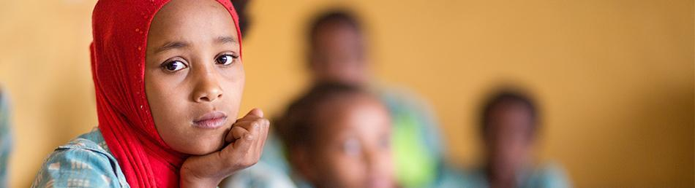

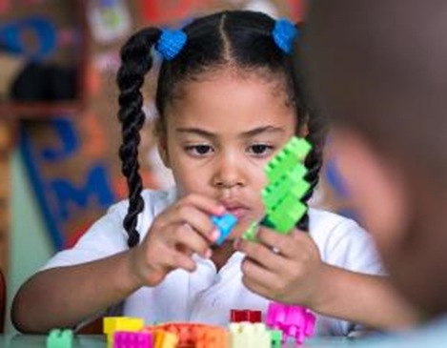
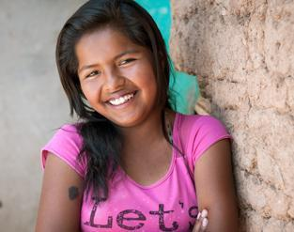
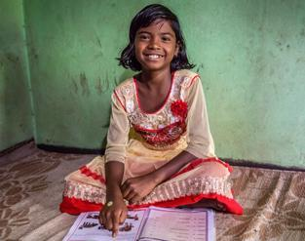
Child Protection and Education
Integration during COVID-19
Salome Ndemi Mullei, World Vision International

Slide 6
Common Concerns in Child Protection & Education during COVID-19
Disruption to schooling exposes children to increased protection risks e.g. increases in teenage pregnancy by as much as 65 per cent - https://www.wvi.org/publications/report/coronavirus-health-crisis/covid-19-aftershocks-access-denied
01
Increase Child Protection concerns increase the likelihood of school drop-out
02
Extended disruption to children’s routines & peer interaction increase MHPSS needs
03
04
Increased barriers for marginalized groups from accessing education
05
Child Protection & Education are not considered as ‘essential services’
Notes:
These concerns arose from the CP AoR survey done during COVID and the education cluster as well as World Vision’s COVID-19 AFTERSHOCKS: ACCESS DENIED REPORT IN 2020: TEENAGE PREGNANCY THREATENS TO BLOCK A MILLION GIRLS ACROSS SUB-SAHARAN AFRICA FROM RETURNING TO SCHOOL

Slide 7






Processes that support Child Protection & Education Integration
CPAoR/GEC
Focus on coordination
Three processes
Alliance/INEE
Focus on practitioners
CP-EiE Technical Unit and Blended Learning Programs
Focus on operations

Slide 8

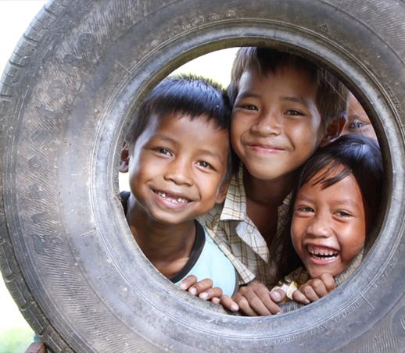
Resources on Child Protection and Education integration
Nurturing Care Framework - A framework for helping children survive and thrive to transform health and human potential available via https://nurturing-care.org/about/what-is-the-nurturing-care-framework/
Position Paper on Collaboration across Child Protection and Humanitarian Action and Education in Emergencies available via https://alliancecpha.org/en/child-protection-online-library/position-paper-collaboration-across-child-protection-humanitarian
CP-EiE Collaboration-Key considerations during COVID-19 pandemic available via https://educationcluster.app.box.com/s/gl0f27xclcb1vjbve60s04tor0svjqgd
Safe back to school: A Practitioner’s Guide available via https://educationcluster.app.box.com/v/Safeback2schoolGuide

Slide 9
Resources on Mental Health and Psychosocial Support Integration
Briefing note on addressing mental health and psychosocial aspects of COVID-19 Outbreak available via https://inee.org/resources/briefing-note-addressing-mental-health-and-psychosocial-aspects-covid-19-outbreak
Mental Health and Psychosocial Considerations During COVID-19 Outbreak available via https://inee.org/resources/mental-health-and-psychosocial-considerations-during-covid-19-outbreak
Guidance for COVID-19 Prevention and Control in Schools Annex C: Mental Health and Psycho-Social Support (MHPSS) available via https://inee.org/resources/guidance-covid-19-prevention-and-control-schools-annex-c-mental-health-and-psycho-social

Slide 10


World Vision Child Protection & Education Integration Pack
Resource 1
Resource 2
Consists of a table that provides suggestions around 3 shared objectives
Includes outcome and output levels indicators
The list of suggested activities will need to be adapted over time
A ‘Household Kit’ for promoting resilience, protection and learning
Combines internal & external resources in a Kit for distribution
The materials included cover some key areas for integration between CP & Education
Notes:
This resource is available upon request

Slide 11
World Vision Child Protection & Education Integration Pack
General Considerations:
Integration should be implemented throughout the project cycle, not only within single activities
Preferably to refer to both resources to maximize integration efforts.
Distribution of CP & Education Kits should be complemented by follow-up, monitoring & evaluation of the intended outcomes.
Coordinate with Ministry of Education, Ministry of Social Affairs, other relevant ministries as well as the clusters.

Slide 12
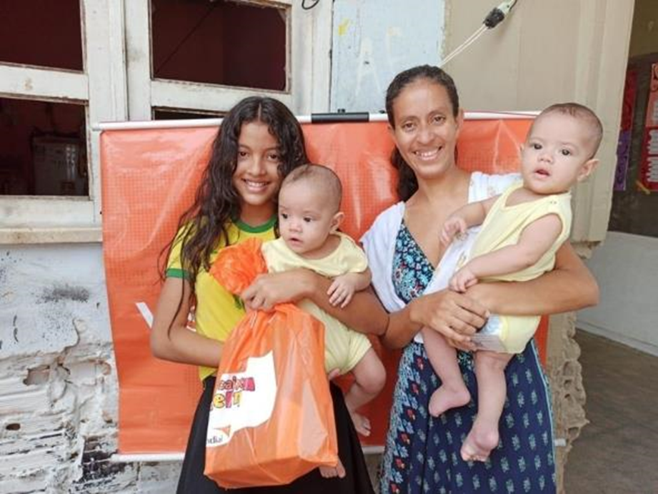

Thank you!

Slide 13

Impact of COVID-19
Lessons learned with regards to CP and MHPSS
World Vision Mali
Martin Diarra, World Vision Mali

Slide 14
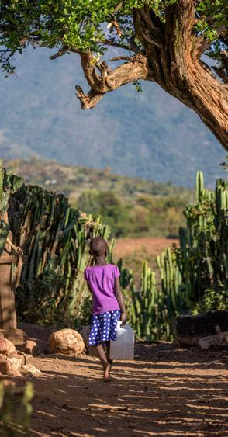

Impacts of the COVID-19 pandemic on children
An increase in violence at home and in the community. Children are exposed to sexual violence: (sexual abuse/rape cases) as well as increased cases of child marriage;
Disruption of education (closure of schools, risk of drop-out): Children no longer enjoy their right to education. Children will unlearn what they have already learned
Increase of child labour: Exposure of children to the worst forms of exploitation (increase in children being forced to work);
Lockdown has disrupted their social life;
Exposure to inappropriate content on the internet (Increase in juvenile delinquency);
Economic hardship and food insecurity (Insufficient financial resources to meet the enormous needs of children)

Slide 15
World Vision Mali COVID-19 response 1/2
Strengthen prevention measures to slow the spread of COVID-19
Support health systems (8 regions) and workers by providing Hygiene Kits (medical mask and FPP2, hand washing kits, hydro-alcoholic gel, thermo-flash, gloves) at National and regional level.
Promote preventive measures to stop or slow the spread of COVID-19 by conducting WASH activities and promoting the use of Wash Kits, sanitizers, tissue, soap…)
Reinforce traditional communicators capacities on COVID-19 within health areas in order to involve them in awareness activities against COVID-19.
Training of primary and secondary school teachers on barrier measures and COVID-19 protocol to reopen schools;
Training of children’s club monitors to support children in communities on protection.

Slide 16
World Vision Mali COVID-19 response 2/2
Reduce the impact of the epidemic on most vulnerable children and their families by multisector projects
Assistance of vulnerable households impacted by COVID-19 through the cash programming to cover the need of food and nutrition.
Establishing appropriate environment for children protection against various forms of violence and abuse during COVID-19 period at the community level;
Strengthen Faith leader’s capacities to support psychologically families that are victims of pandemic and develop sermons that can prevent stigma and provide hope in COVID-19 pandemic;
Providing Psycho-social support and care for children, teachers and pedagogical advisors;
Raising awareness through radio messages on the harms of child marriage, schooling of children, especially during the COVID-19 period
Sensitization of parents to ensure that pupils learn at home and specifically those in examination classes;

Slide 17
Lessons learned
Children and young people involvement in decision-making - Recognition and acceptance of children and young people as rights holders and social actors who can contribute to stopping the spread of COVID-19;
Safe child participation during use of virtual learning platforms - Have safe, sensitive and meaningful child participation, including the provision of age-appropriate information to keep them safe;
Life skills incorporation into distance learning programs - This will help children and young people recognize and mitigate violence, exclusion, stigma and poverty-related risks as well as prevent rising rates of child labor and child marriage;
System strengthening: Ensure preparedness and prepositioning of resources and technical capacities among line ministries, cluster partners and donors for access to age-appropriate and gender-responsive distance education methods to mitigate disruption school closures due to COVID-19.

Slide 18

General Lessons Learned and Best Practices on Linking Child Protection and MHPSS Services with Education Provision
Daria Zanni, Right to Play Switzerland

Slide 19


Agenda of the Workshop
Round of Introduction
First thematic block: General lessons learned and best practices on strategic organizational level - World Vision and Right to Play
Second thematic block: Insights from the operations - Mali and Lebanon - World Vision and Right to Play
Breakout Groups
Wrap-up Session

Slide 20
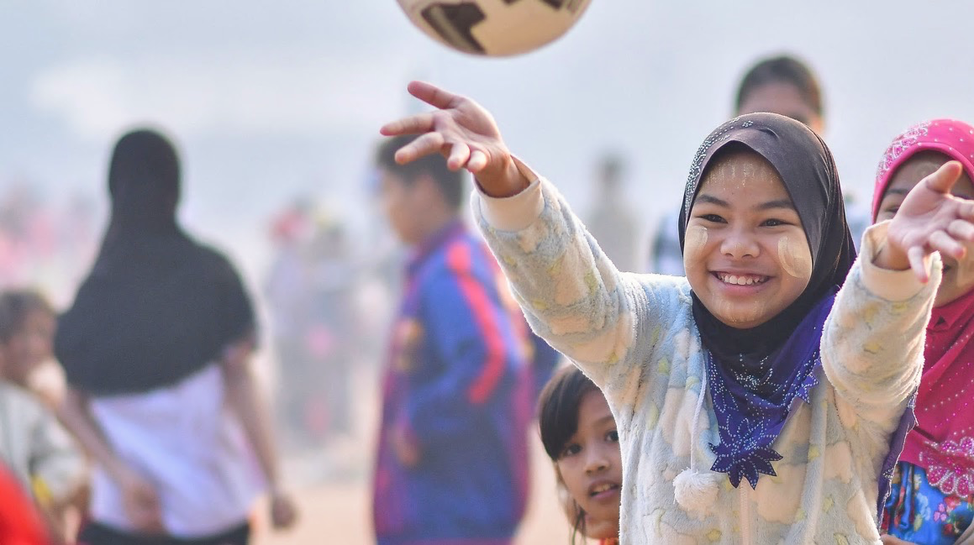
The Importance of Play to Address Psychosocial Challenges
Play facilitates healing, the development of adaptive life skills, healthy development, healthy relationships, fosters a sense of belonging and community, and promotes social cohesion. Neuroscience research shows children manage their stress through play and express their emotions through play where they lack the words (Rushton 2011).
Notes:
20

Slide 21
Prevention of psychosocial risk factors through play during the COVID-19 pandemic
Right To Play drew on its database of 1,000+ game-based resources to develop a social and emotional learning framework with an accompanying collection of games to be used in radio spots, leaflets, TV, and Whatsapp-based distance learning programs. These materials were then distributed via teachers and other partners. Although the lessons in these materials are specific to mental health and psychosocial skills, they can be integrated into academic learning, and Right To Play teams are partnering with ministries of education to disseminate these resources as part of different countries’ distance learning programs.
To promote social and mental health among children and adolescents, we developed the Play@home resource package aimed at:
Supporting the prevention of infection and illness
Reinforcing social relationships
Emphasizing the importance of school and learning through play
Notes:
21

Slide 22
Lessons learned
Increase life skills and emotional learning content in lesson plans: Ideally in crisis contexts, ratio of life skills and emotional learning vs academic content should be flipped.
Digital tools help increase learning flexibility: Connect with more hard-to-reach students, in particular girls.
Children and parents need support to prioritize education: Need to reach out to children and parents with engaging, interactive, playful distance learning lessons that can keep them active and learning at home, and to sensitize parents to the importance of education, especially for girls. (Examples P.O.W.E.R here, Play@Home)
We need to prioritize both student and teacher well-being: Teacher and student well-being are both vitally important for a positive learning environment that positively impacts learning outcomes.
Children exposed to multiple emergencies have complex psychosocial needs: Strengthen play-based psychosocial support (PSS) services for children who have suffered from COVID-19 trauma and are at the same time exposed to the negative impacts of other crises.
Notes:
22

Slide 23

StreetTraxx – A Digital Music Creation Tool
Ma’amoun Salhab, Right to Play Lebanon

Slide 24
Music for Social Change - Snapshot
In late 2018, Right to Play began piloting a Music for Social Change project which entails having youth and children participate in PSS/Lifeskills sessions delivered through RTP’s play-based methodology.
In late 2019 and early 2020, children in different groups, were able to fully create songs that tackle issues such as early marriage, access to education, racism, etc. These songs were eventually performed live during a community event which hosted key stakeholders including caregivers.
As of mid-2021, the M4SC project has reached 556 children in collaboration with partners in Beirut and South of Lebanon.
2021’s mid-term evaluation shows that 83% of participating children reported that online music sessions made them feel better during lockdown; along the same lines, 92% of participating children who attended online sessions, said that the sessions encouraged them to listen and produce more music.
In early 2020, and due to the Covid-19 pandemic, face to face activities were dismissed; to ensure sustainability of activities, children began recording music pieces and exchanged them among each other. During that period, online sessions were being held, yet children felt that the process needed to improve and become more interactive. This gave way to the development of StreeTraxx – an online music creation tool through which children can socialize, create their own music, and collaborate among one another to produce pieces and share them across social media platforms.
Play facilitates healing, the development of adaptive life skills, healthy development, healthy relationships, fosters a sense of belonging and community, and promotes social cohesion. Neuroscience research shows children manage their stress through play and express their emotions through play where they lack the words (Rushton 2011).
Notes:
24

Slide 25
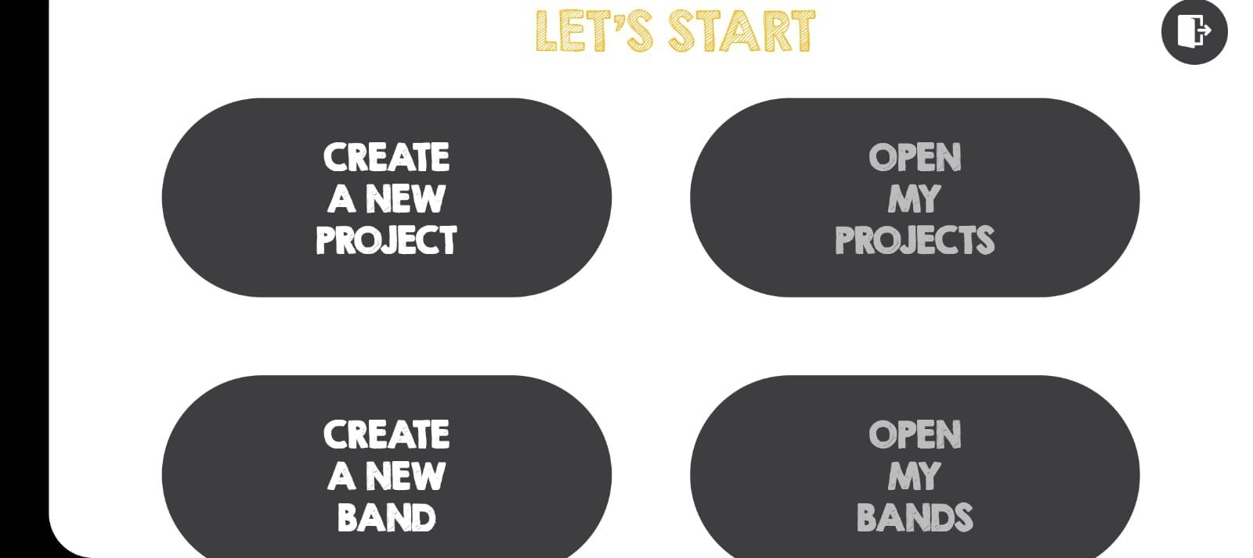

StreetTraxx
StreetTraxx is currently being piloted with a small group of children for debugging purposes and to suggest improvements;
The app aims at equipping children with a powerful online tool to create music in both individual and band formats. The app has several functionalities to allow for an immersive and engaging experience. These include:
A huge library of sampled instruments and misc sounds from nature, households, and communities;
A recording function through which children could add their own recorded sounds;
A multi-channel mixer to allow for advanced mixing of endless sounds;
Real time collaboration, editing, and video conferencing among different band members;
Offline function to allow for users to use the app fully while not connected to the internet;
Sharing function to help spread videos and songs to wider audiences.
Notes:
25

Slide 26
StreetTraxx & PSS
The music platform allows children to exercise the following competencies & skills:
Self-expression: creating a platform for safe and inclusive expression through music creation;
Teamwork/Collaboration: while the app does have an solo option, it is at its most fun in its “band” mode where children will collaborate to create songs together;
Creativity: the app allows children to record, stitch, and mix sounds in any way they like. With multi-channel support, the possibilities are virtually limitless;
Leadership: each band will have leader(s) who will oversee and contribute to the song making process including real-time collaborations;
Concentration: music creation is a very immersive activity that cater to all types of learners; children often go in the smallest details to refine a certain creation;
Patience: while the process is fun – it is always advisable for music creators not to work for hours at a time; in this light, children learn to be patient with their pieces and come back to them later with fresh perspective and ears;
Agency: children will share their music with the world through social media platforms.
Play facilitates healing, the development of adaptive life skills, healthy development, healthy relationships, fosters a sense of belonging and community, and promotes social cohesion. Neuroscience research shows children manage their stress through play and express their emotions through play where they lack the words (Rushton 2011).
Notes:
26

Slide 27
Lessons Learnt & Observations
Lessons learnt and observations are prefaced by the fact that Lebanon has been going through a multi-crisis and it is difficult to attach the below observations exclusively due to Covid-19;
Increased child labor cases: not an exclusive result of the pandemic, but rather a multitude of crises where some families were forced to send their children to work to try to make ends meet.
Increased violence at home: more cases were reported by children on being subjected to familial violence during lockdown;
Increased hyperactivity as many children, post-lockdown, weren’t able to stay focused and sit for long periods of time;
Increased tendency for physical activities manifested in children being more engaged in activities including physical movement, body music, etc.
Increased eagerness for group-work and collaboration activities
Play facilitates healing, the development of adaptive life skills, healthy development, healthy relationships, fosters a sense of belonging and community, and promotes social cohesion. Neuroscience research shows children manage their stress through play and express their emotions through play where they lack the words (Rushton 2011).
Notes:
27

Slide 28
Breakout Group Discussions
4 Groups (1 F2F, 3 online), each of the speaker will be part of one group
Questions - pick and choose!
What were the MHPSS needs that you have encountered in your education programming during the Pandemic?
What were the specific challenges faced by particularly vulnerable groups such as children with disabilities, displaced families, and others? Were there age group or gender specific issues?
Fragile contexts with multiple crises: do you have specific examples of contexts facing multiple crises (disasters, armed conflicts etc.) where the Pandemic created additional vulnerabilities and what were the impacts on your education programming?

Slide 29
Group 2 (Online)
Forced marriage, early pregnancy following crises
Flooding and drought
Displacement of 2 million IDPS in Mali Burkina Niger
School closures (1664 in Mali in August 21)
Notes:
What were the MHPSS needs that you have encountered in your education programming during the Pandemic?
What were the specific challenges faced by particularly vulnerable groups such as children with disabilities, displaced families, and others? Were there age group or gender specific issues?
Fragile contexts with multiple crises: do you have specific examples of contexts facing multiple crises (disasters, armed conflicts etc.) where the Pandemic created additional vulnerabilities and what were the impacts on your education programming?

Slide 30
Group 3 (Online)
MHPSS during Pandemic:
Particularly for vulnerable groups and children, they felt the pressure/burden due to loss of livelihoods. The vulnerable became more vulnerable which created trauma and we saw many people struggling to accommodate distance learning (devices etc.) which created another layer of stress; even if they have online classes, they were not able to access.
In a nutshell, burdens on children had become more and their chances of being integrated in the mainstream society has diminished. Because some parents lost their jobs, this increased the pressure on children. Not clear strategies on how to approach children’s development in the pandemic.
For CwD specifically - are further vulnerable to become part of extreme forms of abuse, etc.
Notes:
What were the MHPSS needs that you have encountered in your education programming during the Pandemic?
What were the specific challenges faced by particularly vulnerable groups such as children with disabilities, displaced families, and others? Were there age group or gender specific issues?
Fragile contexts with multiple crises: do you have specific examples of contexts facing multiple crises (disasters, armed conflicts etc.) where the Pandemic created additional vulnerabilities and what were the impacts on your education programming?

Slide 31
Group 4 (F2F)
Poverty itself is a complex crisis - how was it addressed? Support to parents, enhance parent’s capacities on how they can support their children, so that the relationship between parents and children can be changed.
Hunger
What have we learned that creates more resilient education systems
Notes:
What were the MHPSS needs that you have encountered in your education programming during the Pandemic?
What were the specific challenges faced by particularly vulnerable groups such as children with disabilities, displaced families, and others? Were there age group or gender specific issues?
Fragile contexts with multiple crises: do you have specific examples of contexts facing multiple crises (disasters, armed conflicts etc.) where the Pandemic created additional vulnerabilities and what were the impacts on your education programming?

Slide 32
What concrete steps will you implement (in your own work/ with partners/ in your future work)?
Making education accessible - continuing Education Support Centers at their community level after the formal school hour since the parents are uneducated, cannot support their children.
Breaking the social and systemic barriers by creating awareness about the importance of education to children, especially Girls - most of the parents plan to give the girls in marriage as soon as they attain puberty.
Helping the formal schoolteachers to make the schools as girls' friendly schools.
Working with the State Child Protection mechanisms to function effectively to safeguard children.
Motivate the Panchayats to create a child tracking system to monitor the children's dropouts or child trafficking or into force labour or modern slavery or child labour…

Slide 33
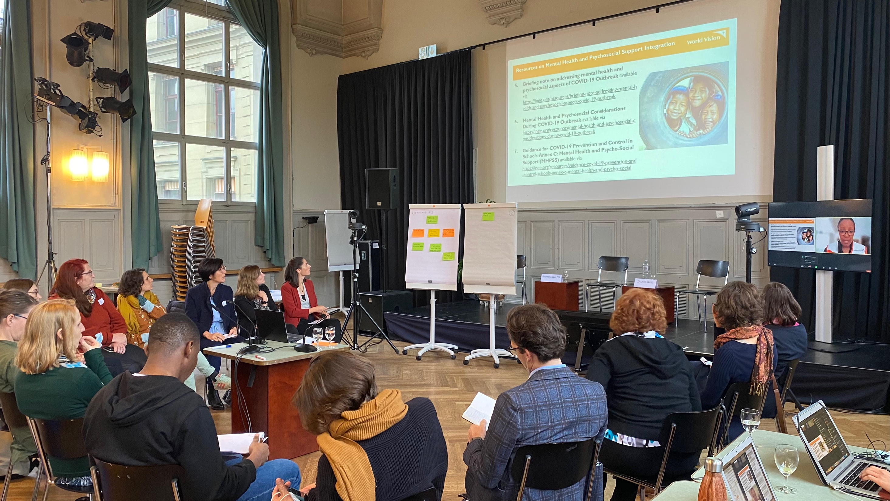
Photos

Slide 34
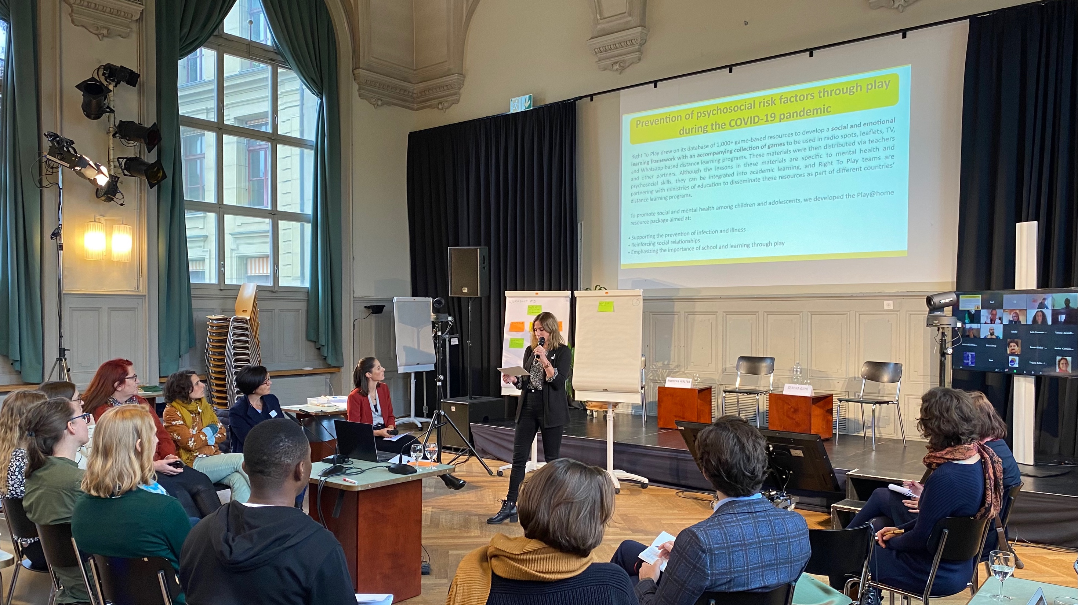

Daria Zanni — Speaker

Slide 35
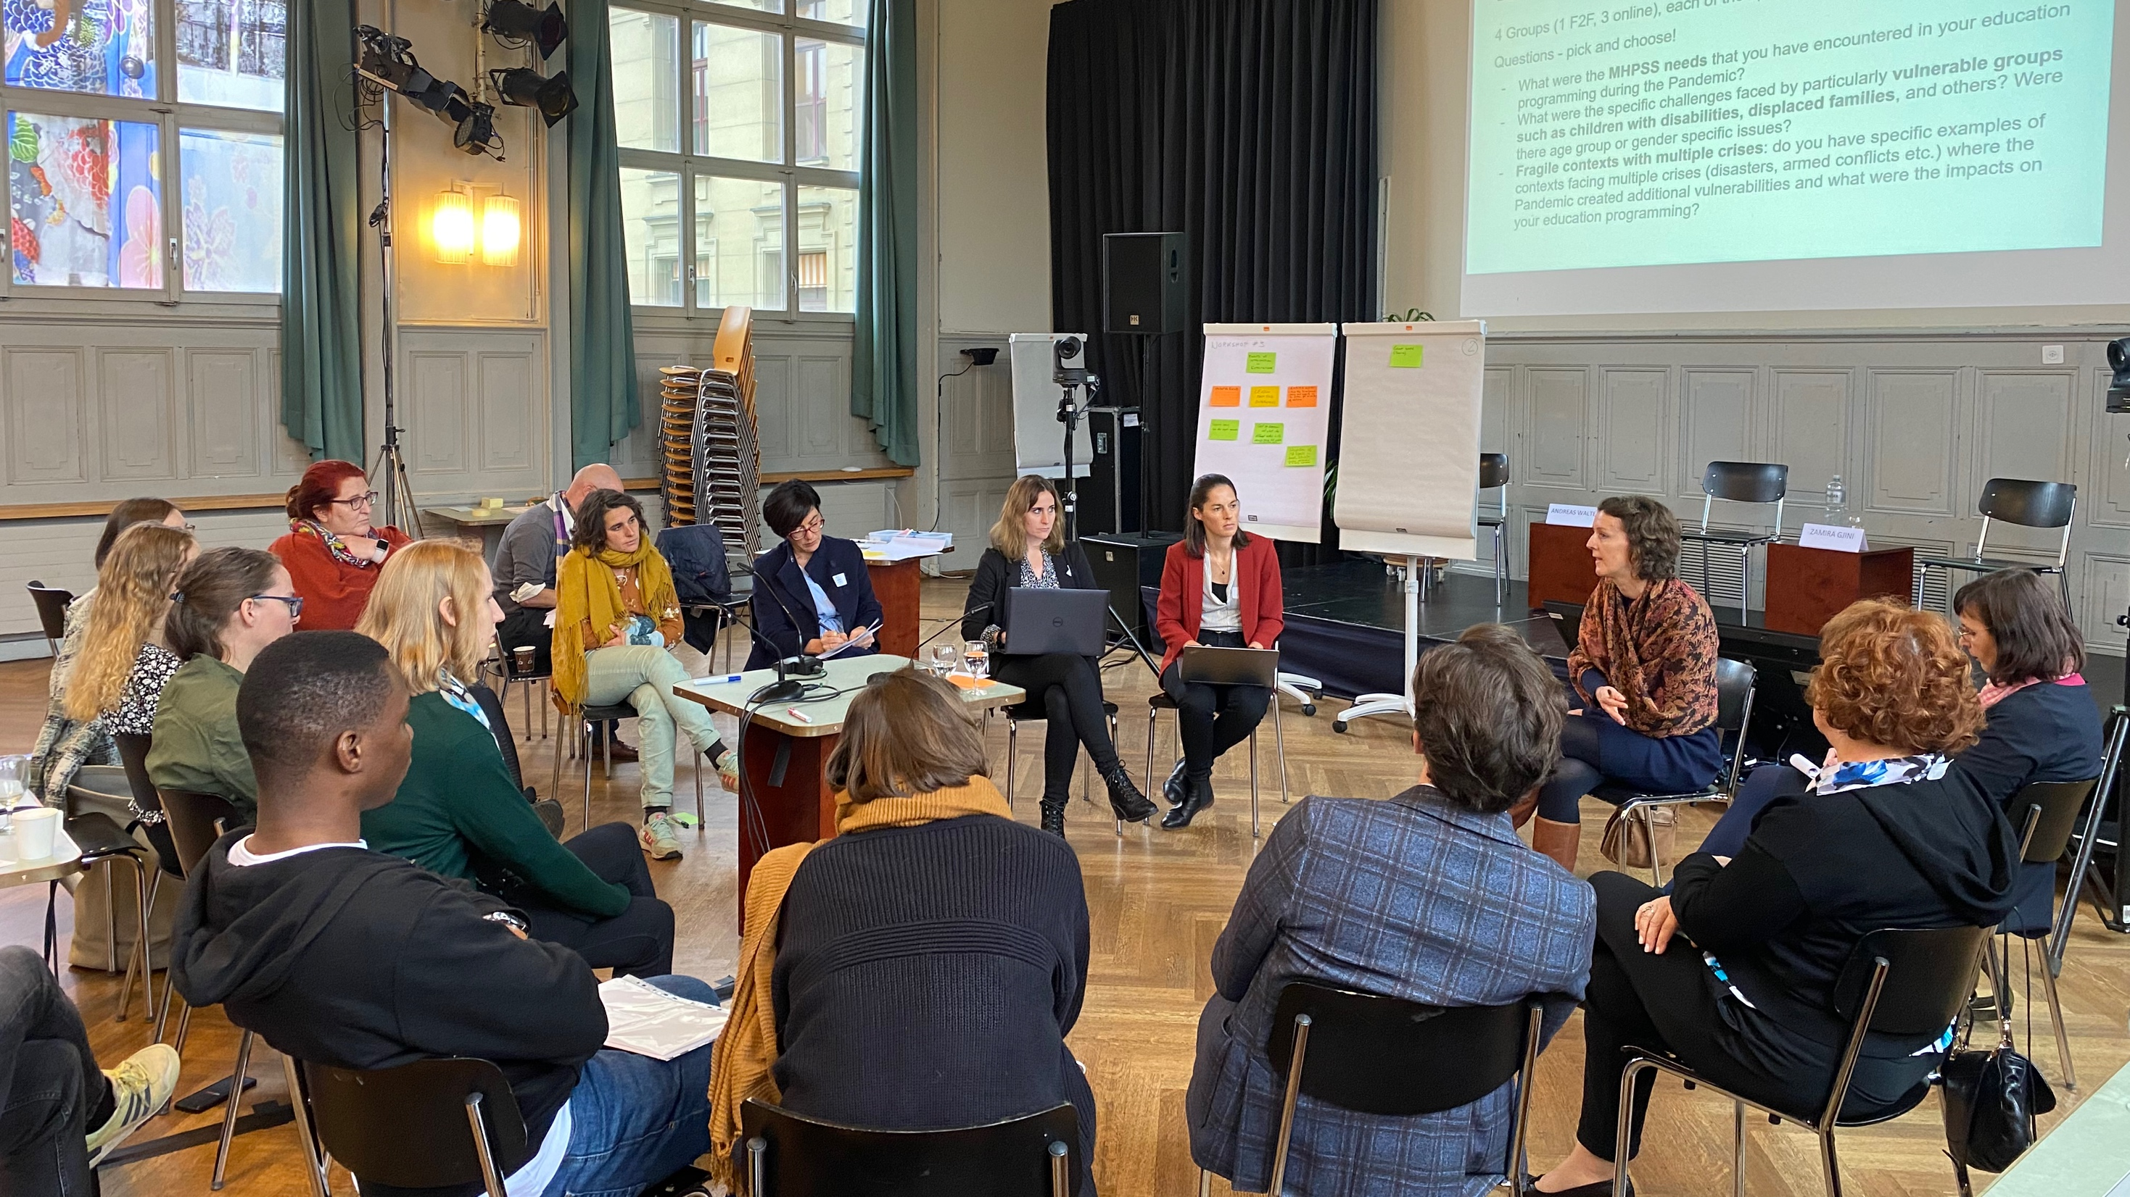

Slide 36
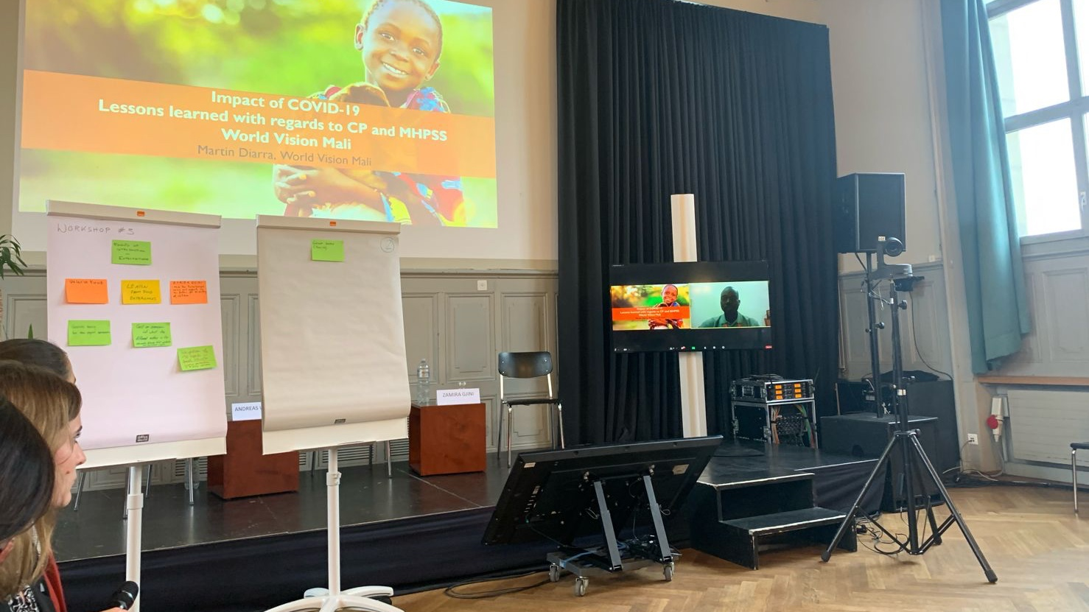

Martin Diarra — Speaker

Slide 37
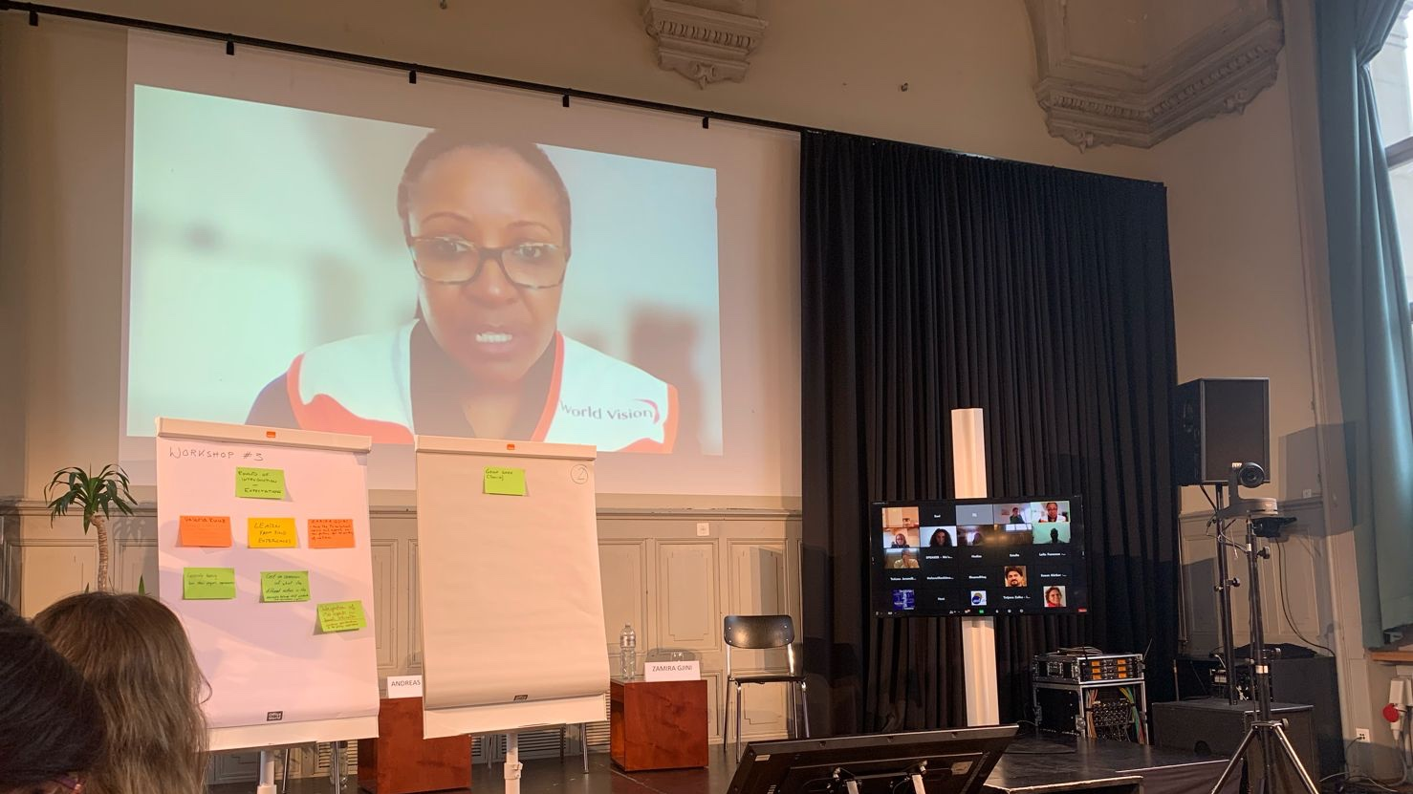

Slide 38
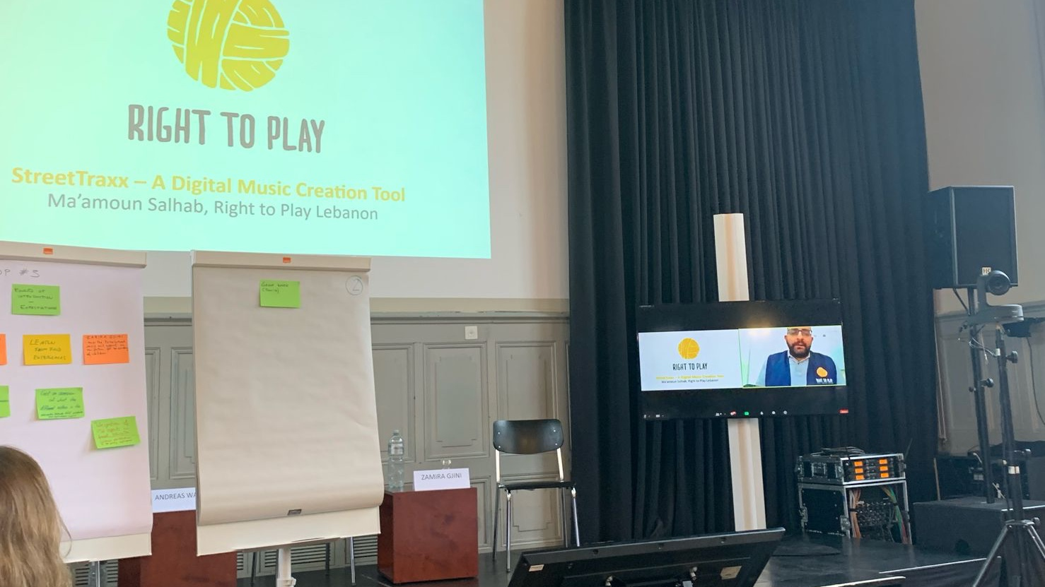
Salhab Ma'amoun — Speaker

Slide 39
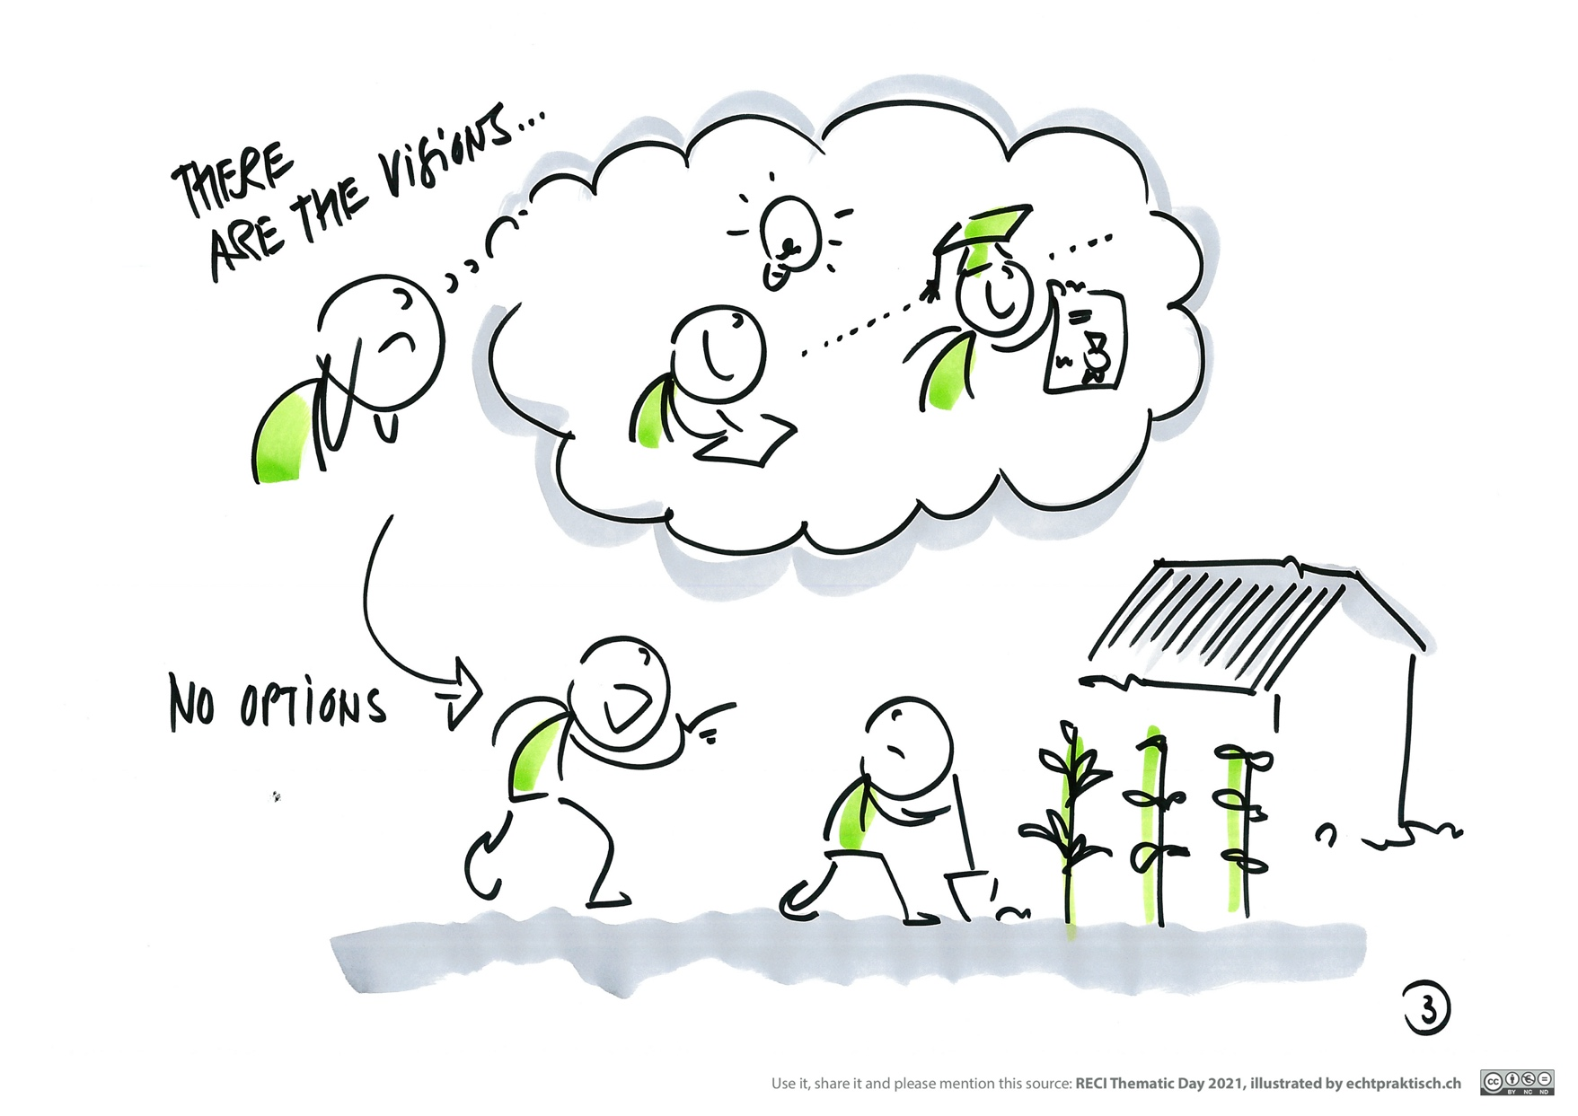
The Pandemic has created more vulnerabilities for children affecting their access to education, particularly in fragile countries. These forces parents and caregivers to force children back into harmful practices such as child labour to cover income losses.

Slide 40
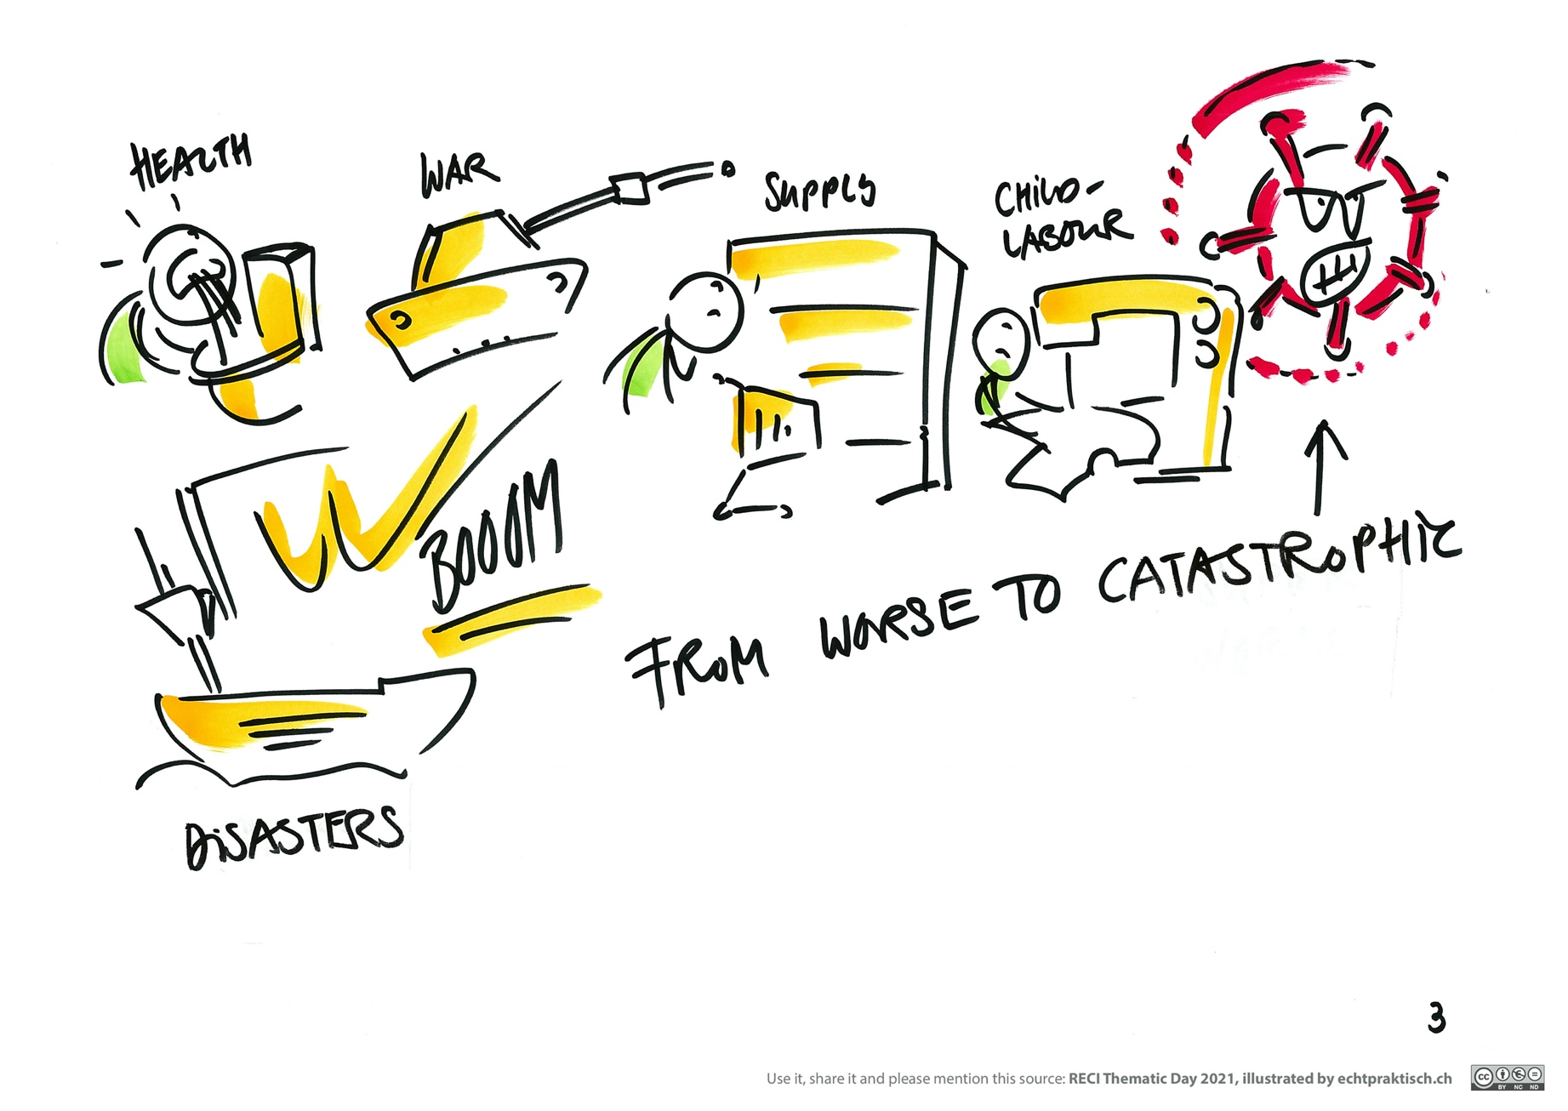
In fragile countries, additionally to school closures resulting in drop-outs, factors such as armed conflicts, lack of food, natural disasters and others have created multiple vulnerabilities for children.

Slide 41
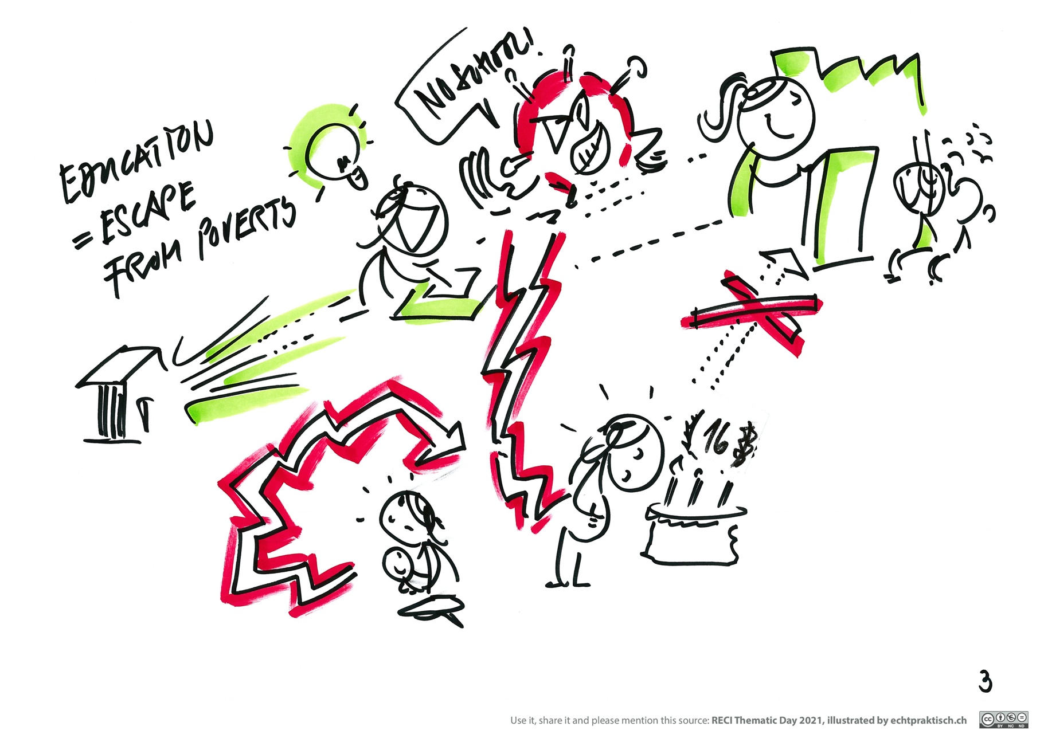
Various child protection issues as a result of school drop-outs such as teenage pregnancies have been observed in fragile countries during the Pandemic.

Slide 42
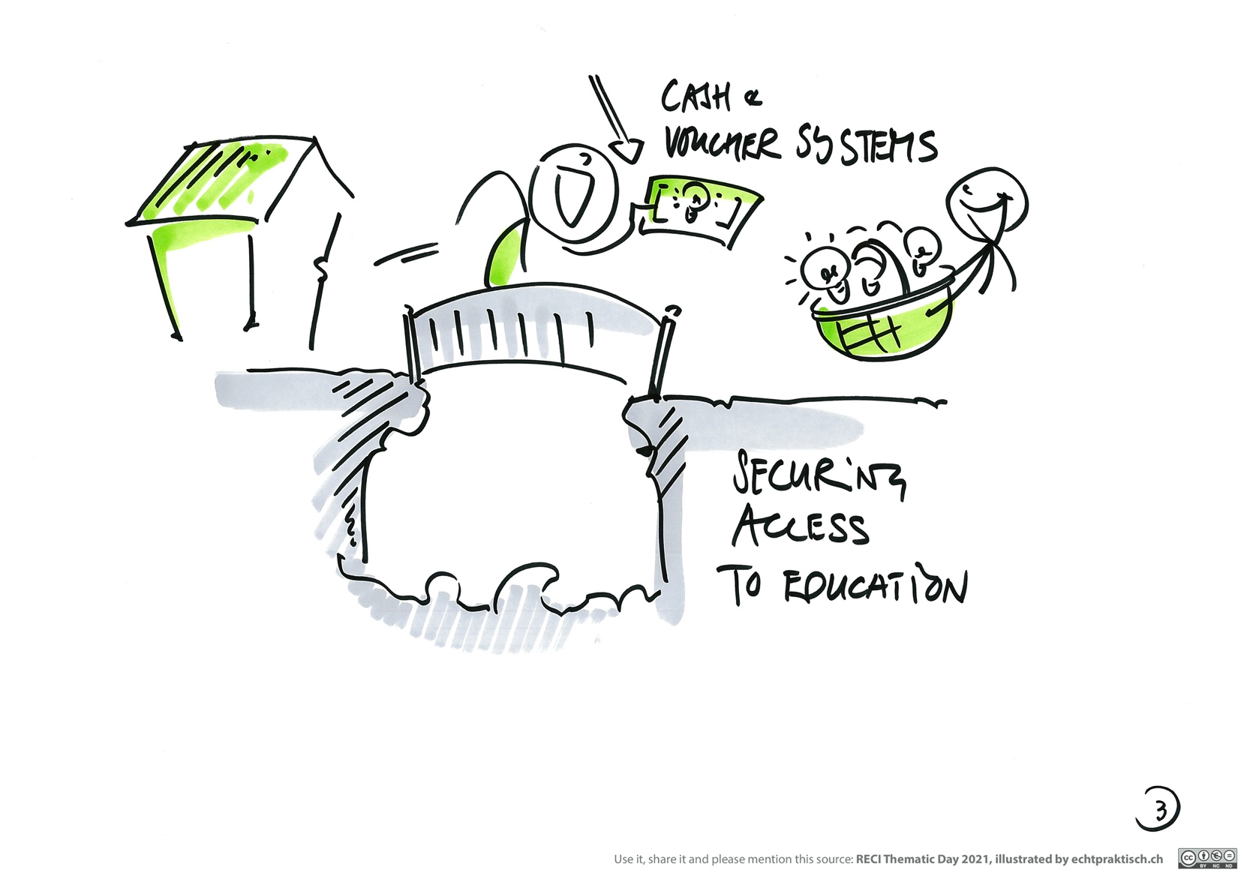
Solutions to secure access to education for the most marginalized children can be found in supporting affected families financially to avoid forcing children into harmful practices like child labour as an obstacle to attending school.

