Slide 1


PANEL DISCUSSION HIGHLIGHTS
RECI THEMATIC DAY 2021
EDUCATION BEYOND
THE PANDEMIC

Slide 2
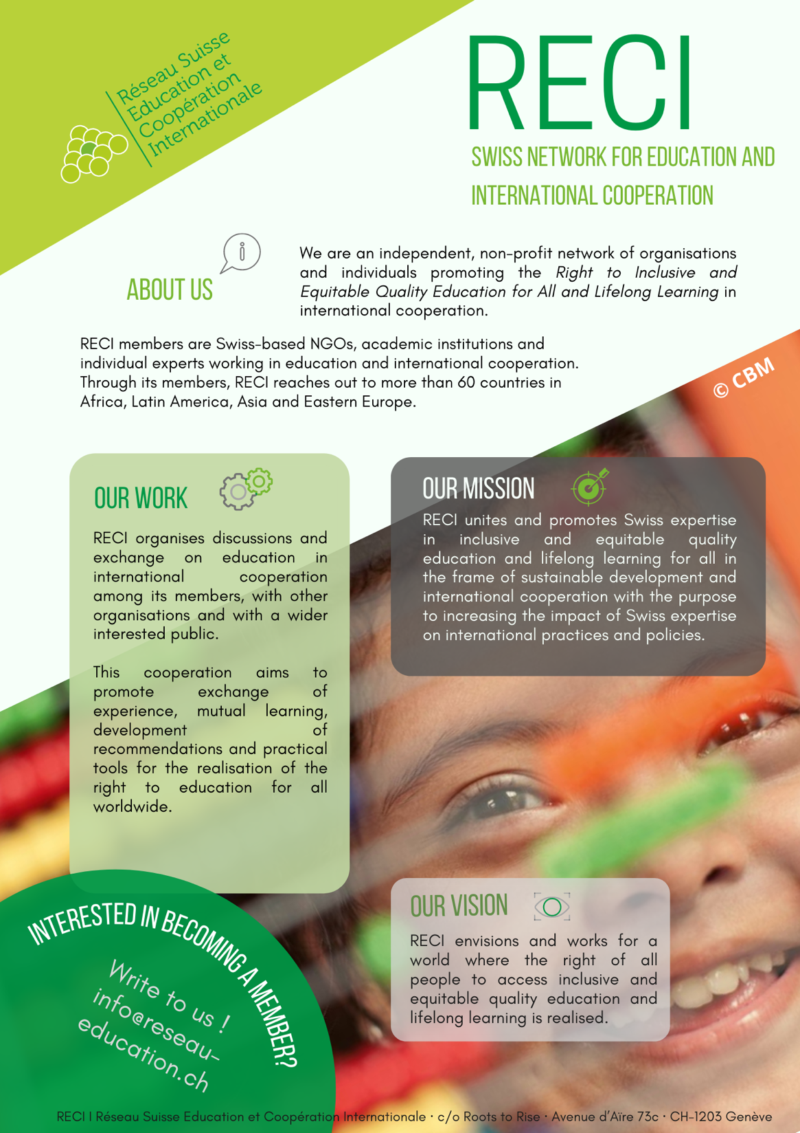
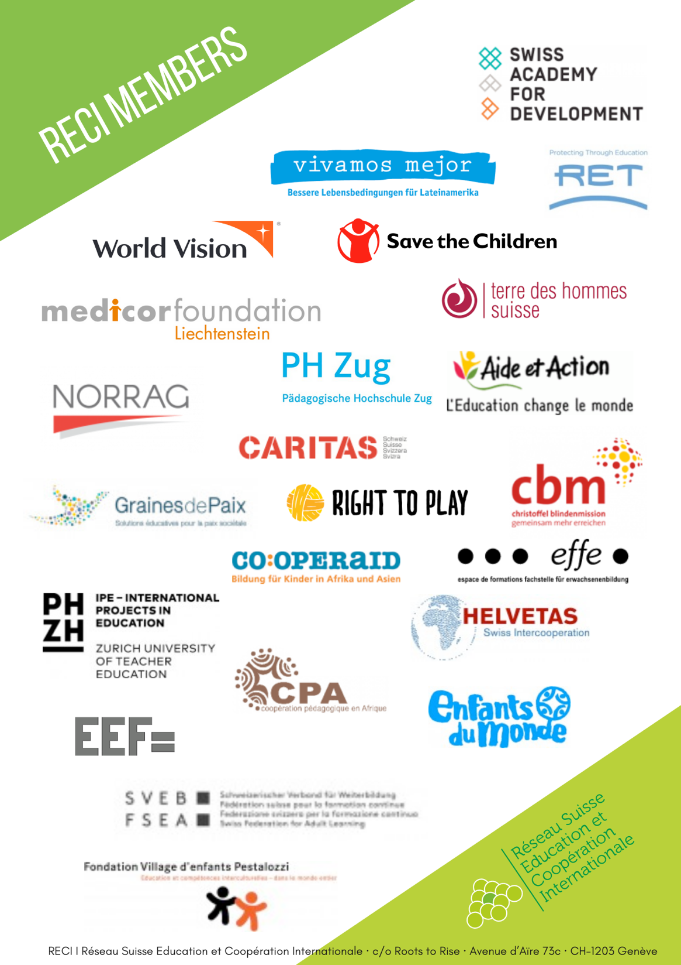
reseau-education.ch

Slide 3
Overview
PANELISTS BIOGRAPHY
HIGHLIGHTS POINTS
VISUAL SUMMARIES
PHOTOS

Slide 4
BIO PANELLISTS - 1
Panel Moderator — Valeria Kunz
Convener of the RECI Working Group “Education in Emergencies” and Head Education at Save the Children Switzerland
Valeria Kunz is providing strategic steer, coordination and technical support to the education programmes of Save the Children Switzerland. She is also the Convener of the RECI working group on Education in Emergencies. Valeria has been working in development cooperation with various non-governmental organizations for more than 16 years, accompanying projects and partners in fragile and development contexts across Africa, Asia, Middle East and South Eastern Europe. She holds a master's degree in Sociology from the University of Berne and a Certificate of Advanced Studies in Development and Cooperation from ETH Zurich. Her main areas of expertise are in quality basic education, early childhood development and education in emergencies. Valeria is a strong advocate for effective and needs-based solutions to promote learning and wellbeing of vulnerable children in an integrated way.
Panel speaker — Sobhi Tawil
Director of the Future of Learning and Innovation Team at UNESCO
Sobhi Tawil is Director of the Future of Learning and Innovation Team at UNESCO and leads the Futures of Education initiative – an ambitious attempt to reflect on and generate debate on how education might need to be re-thought in a world of increasing complexity, uncertainty, and precarity. During his UNESCO career, Sobhi Tawil also headed the Education 2030 Partnerships, Cooperation and Research Team (Paris), the Education Program for the Maghreb (Rabat), and the Capacity Building Program for Curriculum Development at the International Bureau of Education (Geneva). Prior to joining UNESCO, Sobhi Tawil worked with diverse institutions and organizations, including the International Committee of the Red Cross (ICRC), the Graduate Institute for International and Development Studies (Geneva), the Network for Education Policy Research Review (NORRAG), and the International Institute for Higher Education (Rabat).
Dr Tawil holds a PhD in Education and Development from the Graduate Institute for International and Development Studies (Geneva), and a Masters in Comparative Education from the Faculty of Psychology and Education at the University of Geneva.

Slide 5
BIO PANELLISTS - 2
Panel speaker — Zamira Gjini
Director-General for Policies and Development of Education and Sports at Albanian Ministry of Education and Sports
Zamira Gjini holds the position of Director-General for Policies and Development of Education and Sports in Albania. She coordinates policies and strategies in the field of education and sports in the Ministry of Education and Sports. Zamira has an academic background in Natural/Physical Sciences and in-depth studies in educational sciences. She has been a physics teacher and the head of the physics teachers’ department, as well as trainer on teaching methods, education for the rights of the child, education for peace, conflict resolution, and peer mediation. She is a member of the PISA Steering Board as well as of the Strategic Framework for European Cooperation in Education and Training (ET 2020) groups for schools and democratic civic education. Zamira also chairs several National Committees in the implementation of the National Strategy for Development and Integration and has participated in working groups for drafting strategies and laws on, among others, national minorities, Roma communities, gender equality and people with disabilities.
Panel speaker — Sabina Handschin
Head of Education and Senior Education Policy Advisor, Swiss Agency for Development and Cooperation SDC
Sabina Handschin is the Head of Education at the Swiss Agency for Development and Cooperation (SDC) of the Swiss Ministry of Foreign Affairs, representing Switzerland in international and multilateral policy dialogue on SDG 4. She has over 17 years of professional experience in humanitarian aid, development cooperation, peacebuilding and in business, including over 14 years in education. Ms. Handschin has held leadership positions in Switzerland and abroad, managing large scale education programs in several countries.

Slide 6
BIO PANELLISTS - 3
Panel speaker — Andreas Walter
Co-President of the Swiss Conference of Compulsory Education Authorities
Andreas Walter is an educational scientist and holds teaching diplomas for lower secondary education and special education. Walter has been Head of the Office of Compulsory Education of the Canton of Solothurn since 2007, is co-president of the Swiss Conference of Compulsory Education Authorities (within the Swiss Conference of Cantonal Ministers of Education) and is a member of the Swiss Conference of Directors of Centers for Educational Planning, Development and Research (Codicre). From 1999 to 2007, he implemented system-relevant reform projects as a cantonal school developer, including the design of educational transitions. Walter is committed to an elementary school that provides students with core competencies for independent living in society and participation in our culture by teaching them to assess, understand, and cope with problems independently. It advocates for agile school development so that schools can fulfil their core mission.

Slide 7
Highlight points
Zamira Gijini presented some of the best practice examples of ensuring continued learning for the most marginalized children and youth in Albania (through education technology and catch-up classes for example) and emphasised the importance of parental support and teacher training for remote learning in order to be effective.
Andreas Walter did add important considerations from the Swiss perspective, where schools were only closed for a duration of eight weeks. He underlined that schools play a fundamental role for the social wellbeing and mental health of children and that children with more disadvantaged socioeconomic backgrounds also faced challenges in continuing their learning remotely in Switzerland. These fundamental impacts of school closures should therefore be considered in political decision making as the pandemic continues.
Looking at the future of education, Sobhi Tawil presented the findings and key recommendations of the UNESCO Futures of Education initiative, which triggered a global debate on how the future of education may look like.
Sabina Handschin emphasized on the importance of strengthening local governments in building more resilient education systems and to improve coordination in education to achieve results at scale. She also underlined the importance to mainstream elements of gender, health promotion, child protection and social emotional learning into education responses, in order to address learner's needs in an integrated way. All actors agreed on the importance of civil society actors in shaping solutions to ensure continued education for all learners.

Slide 8
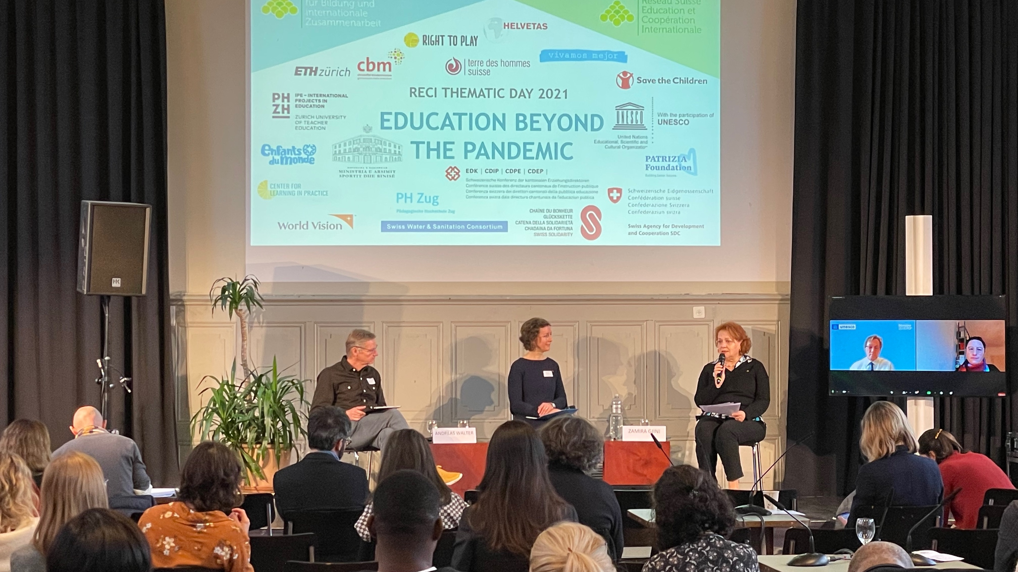
Photos

Slide 9
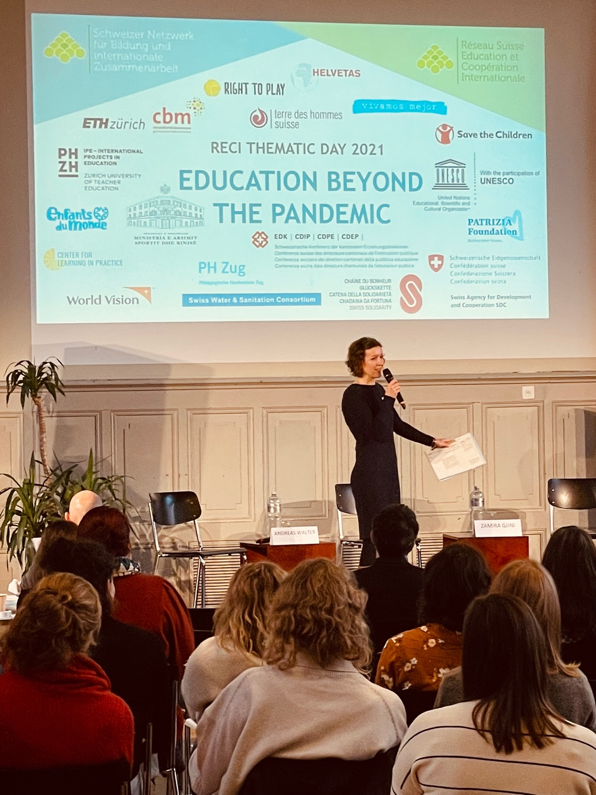
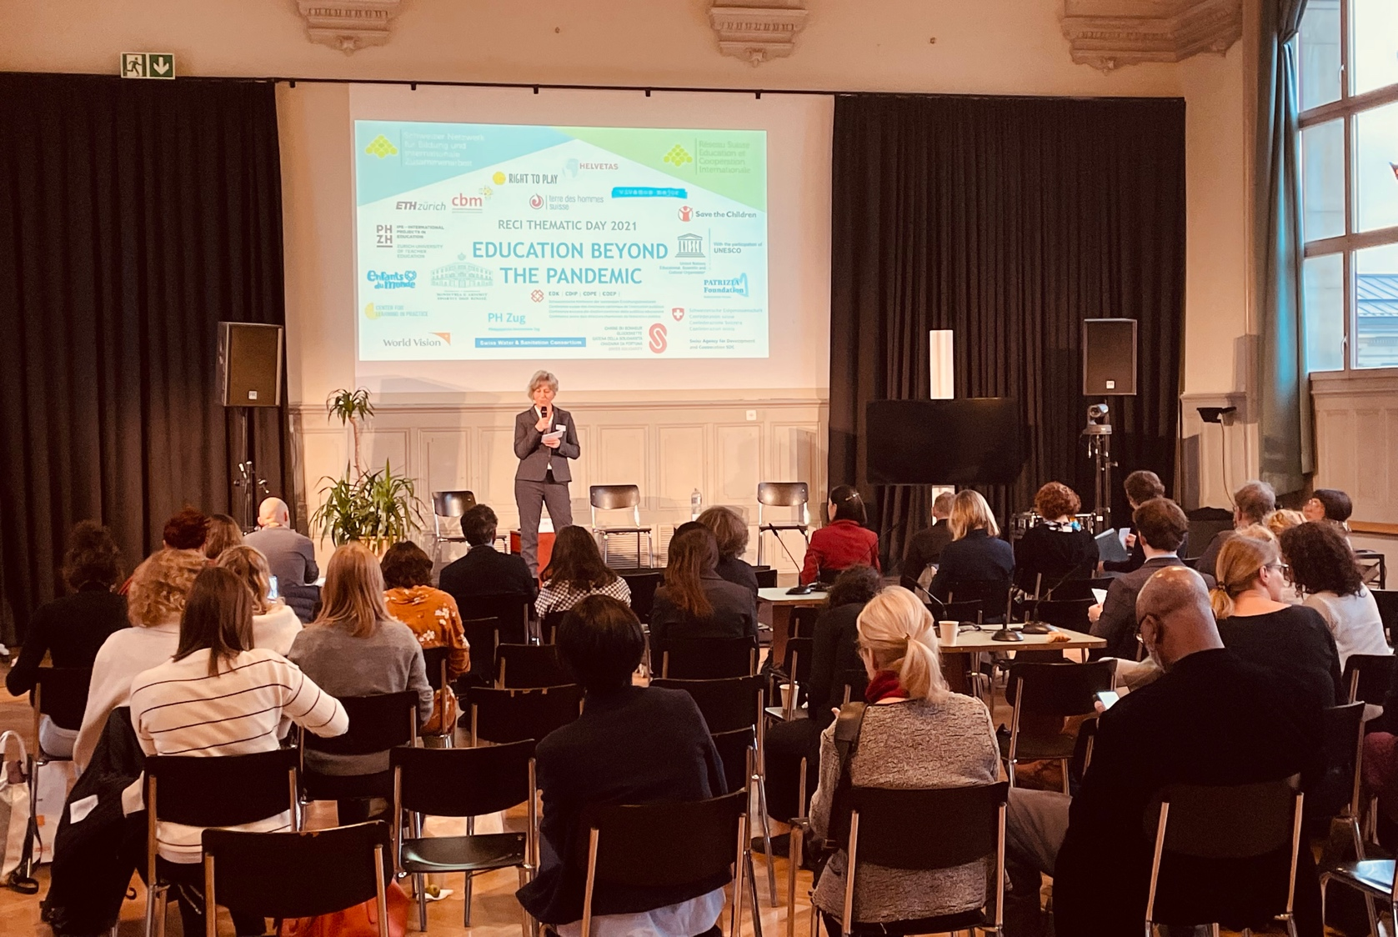
Beatrice Schulter – RECI Executive Director
Valeria Kunz – Panel Moderator

Slide 10
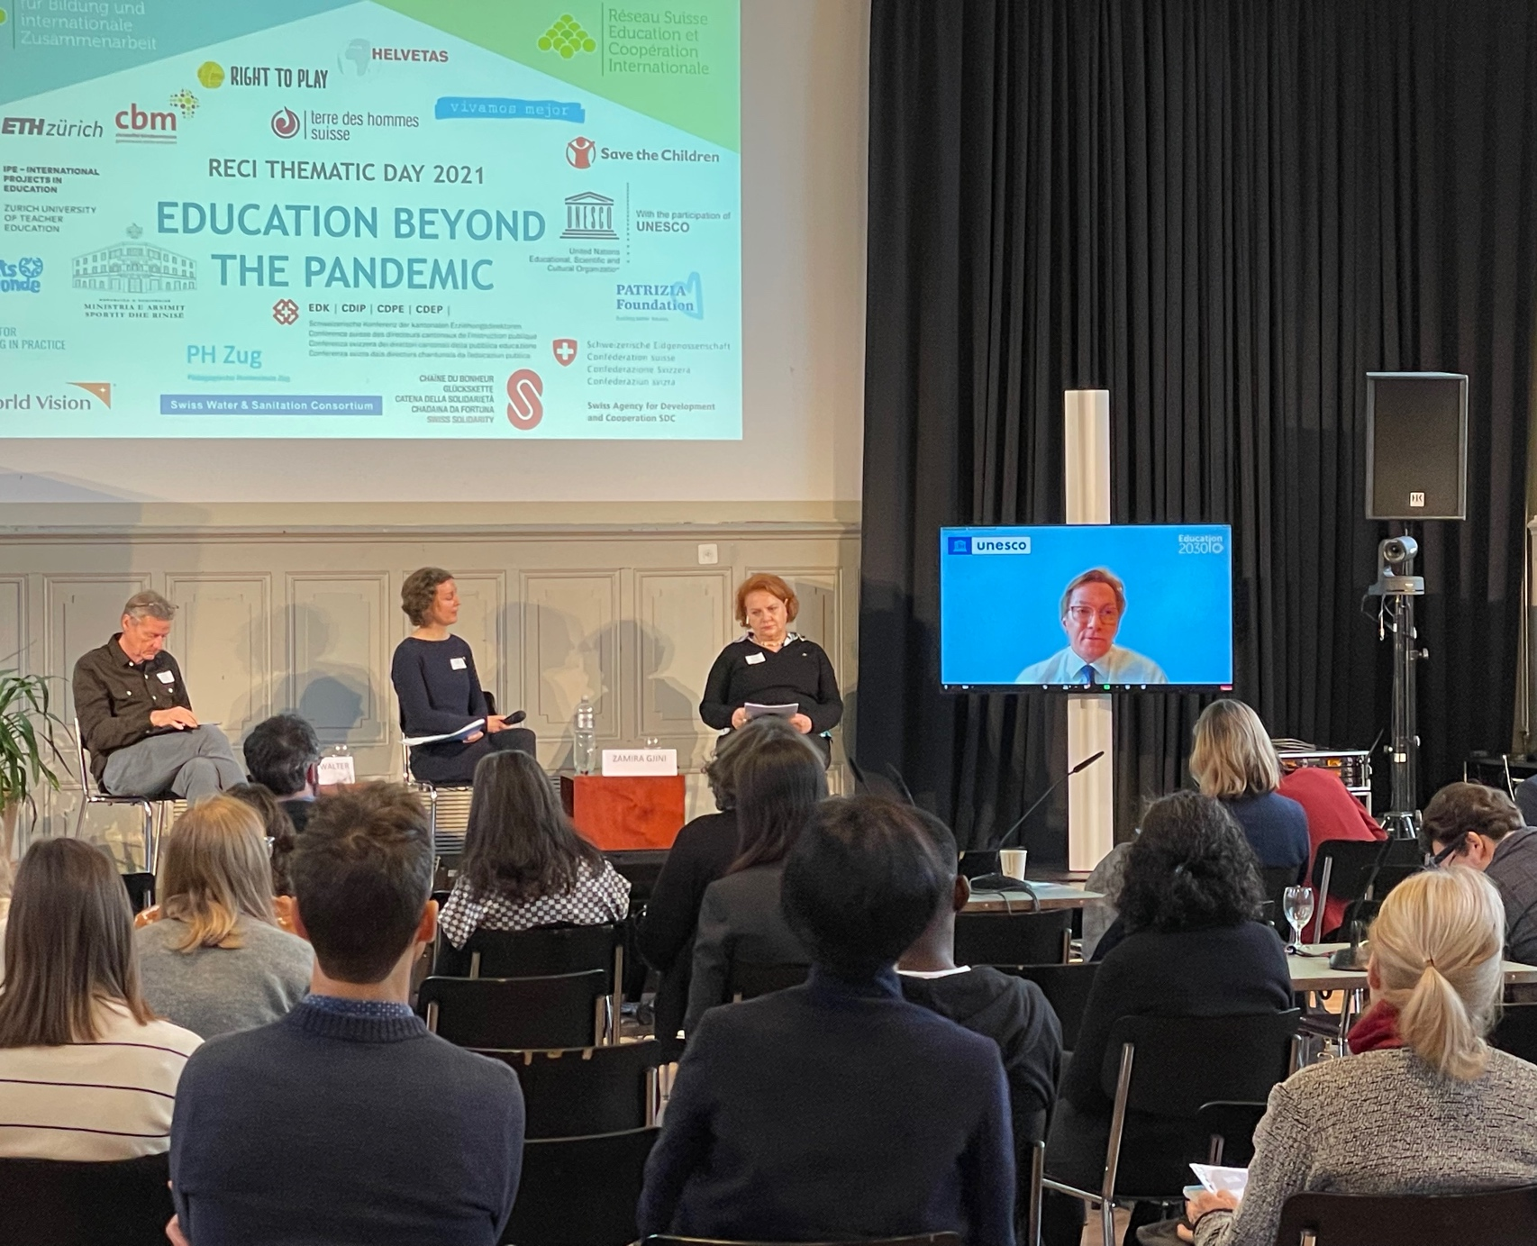
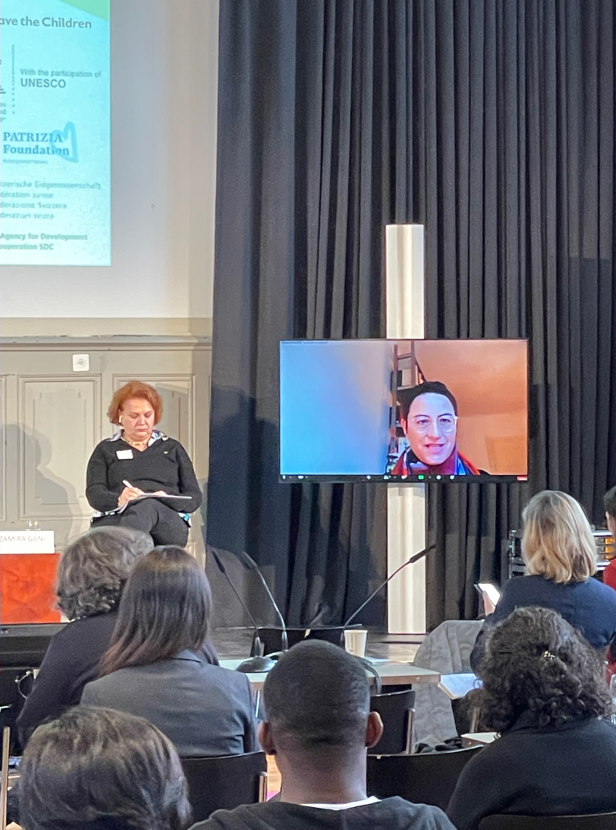
Sobhi Tawil - Panel speaker
Sabina Handschin - Panel speaker

Slide 11
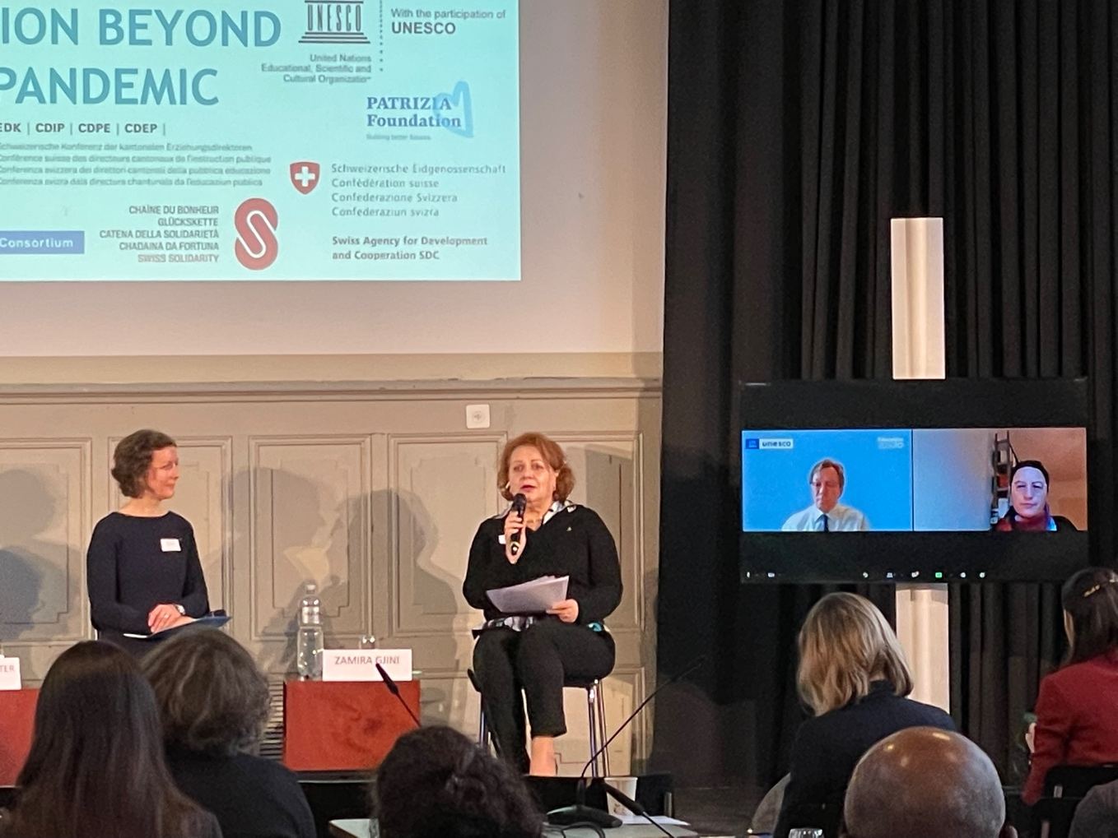
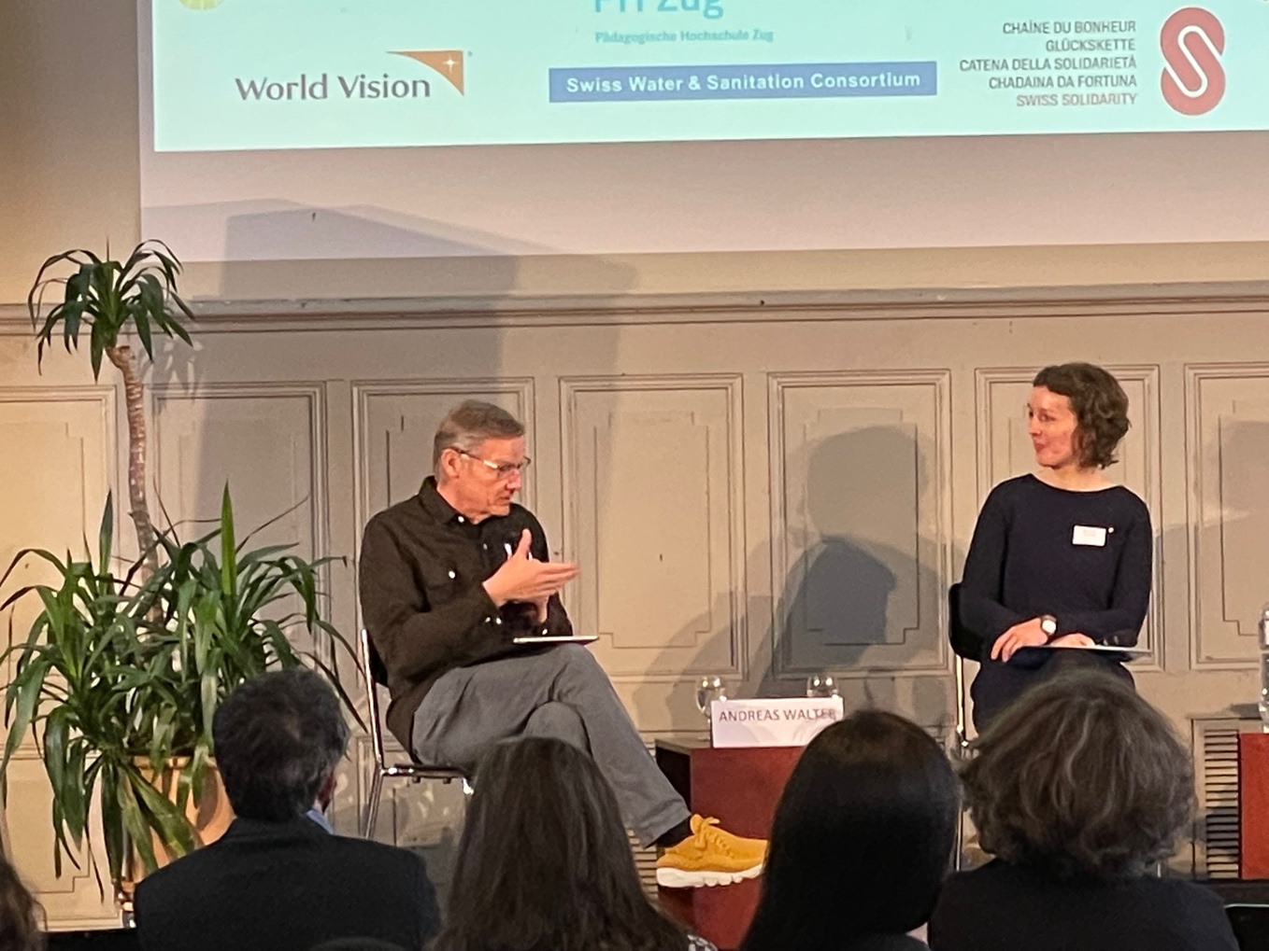
Zamira Gjini - Panel speaker
Andreas Walter - Panel speaker

Slide 12
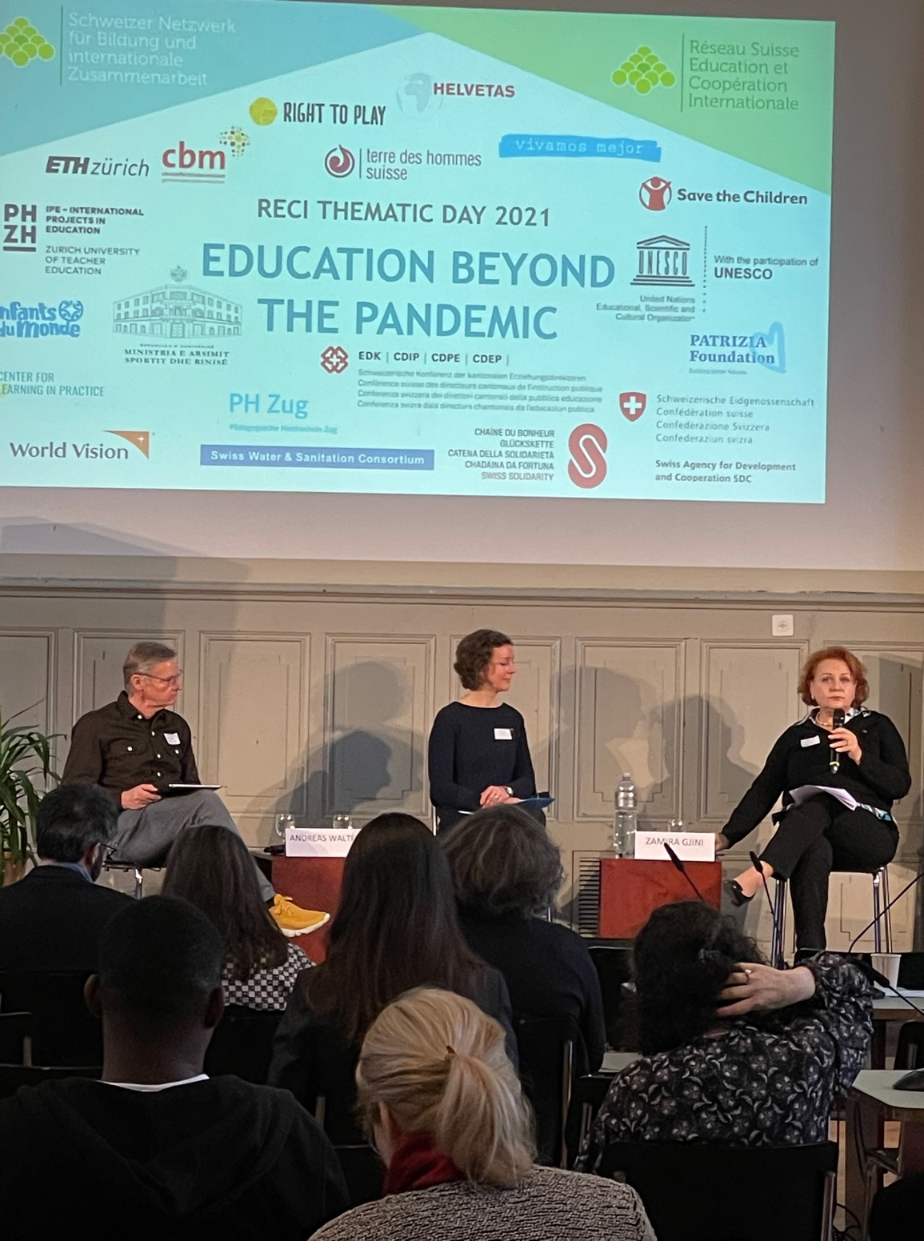
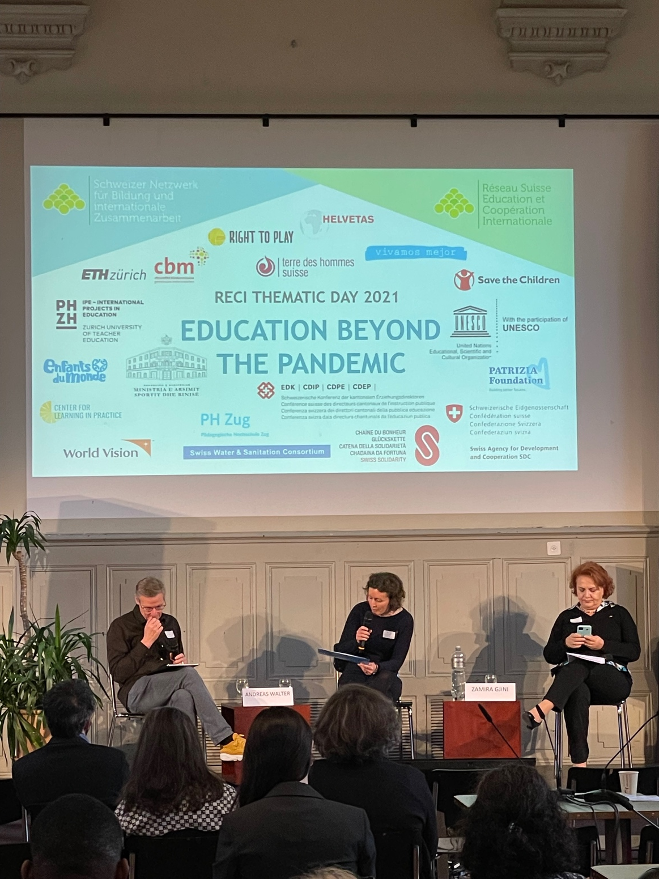

Slide 13
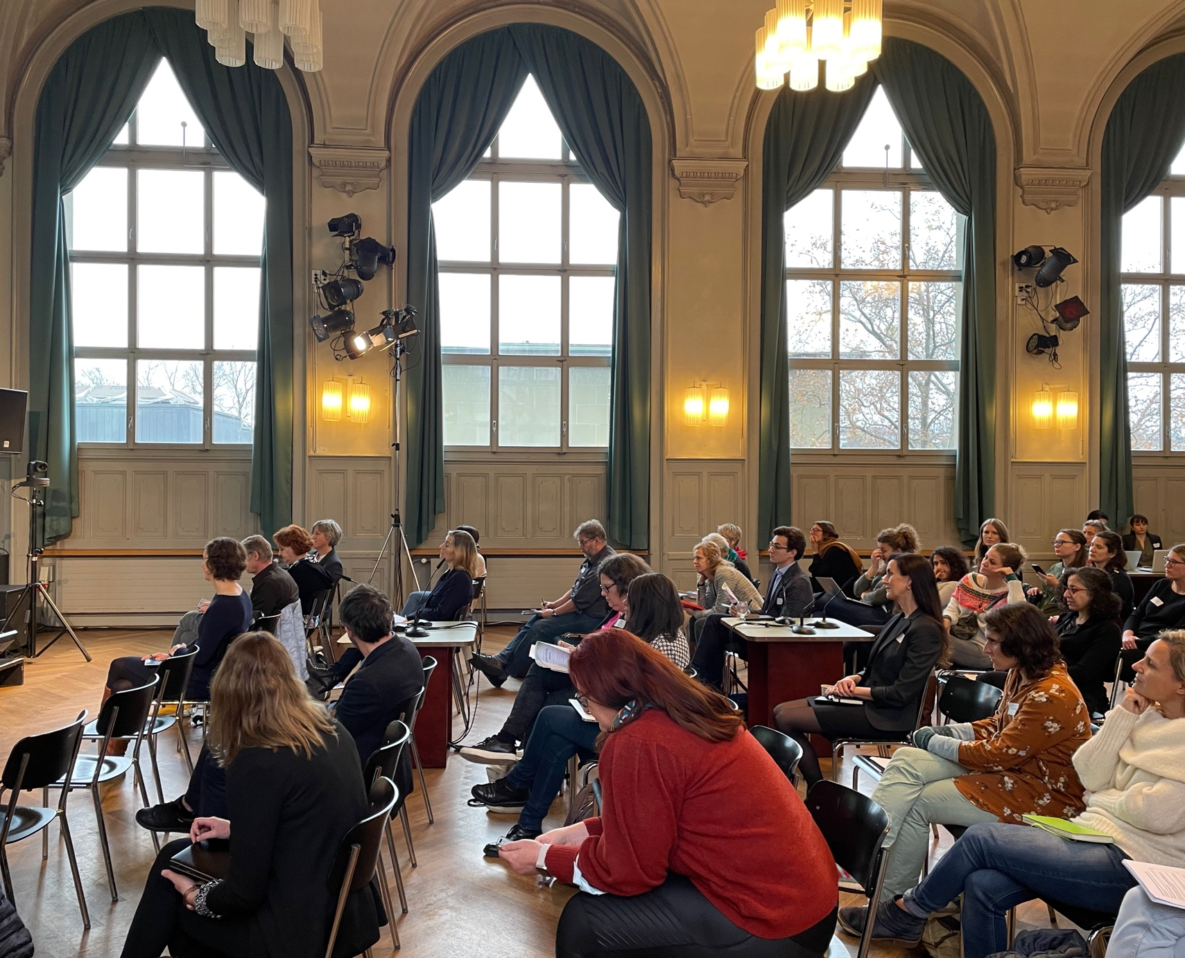
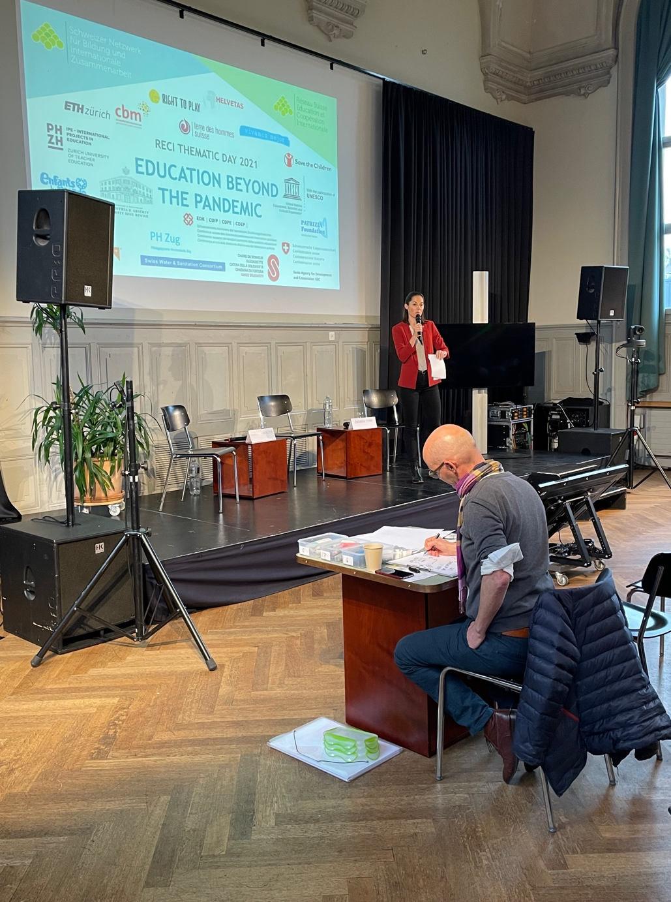

Slide 14
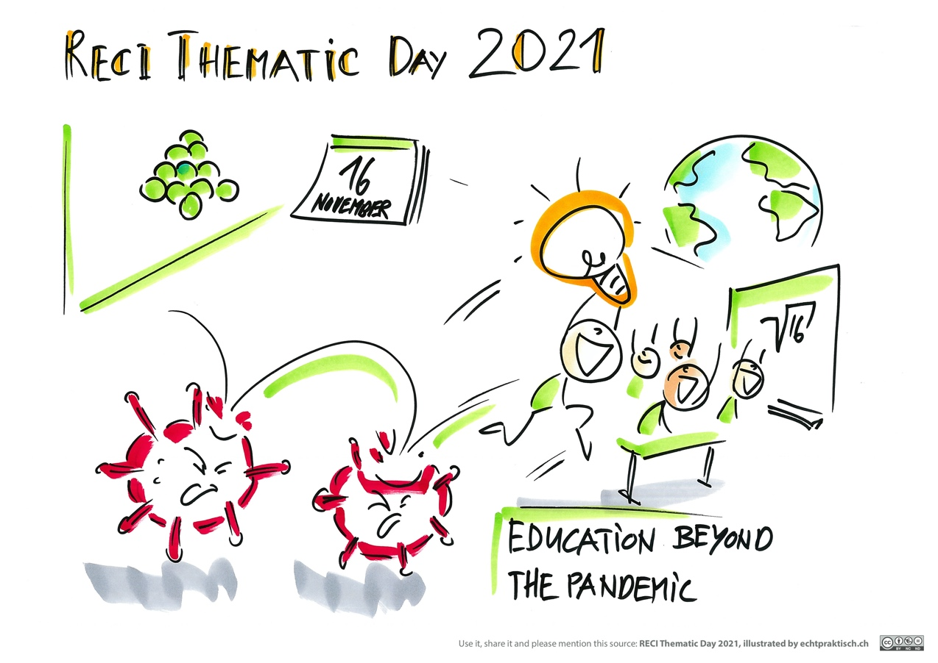
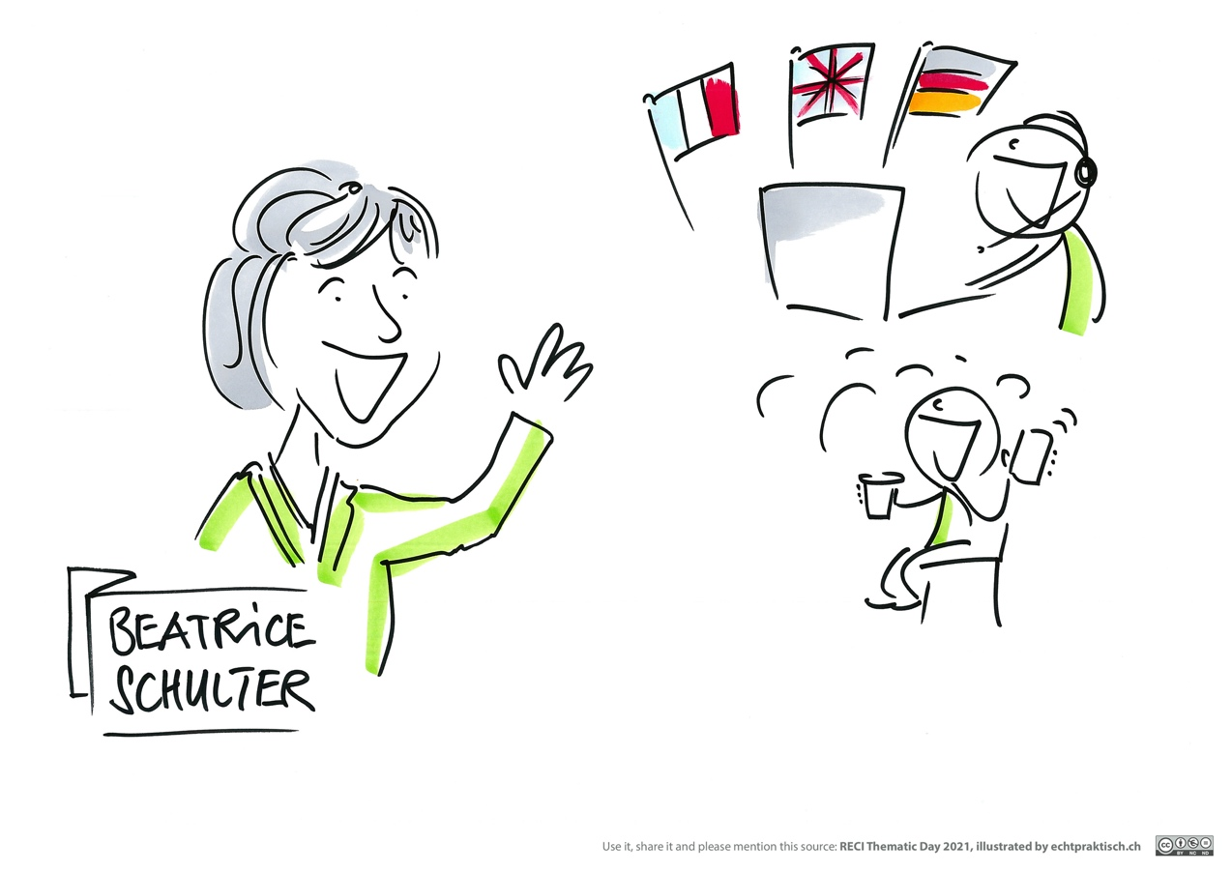

Slide 15
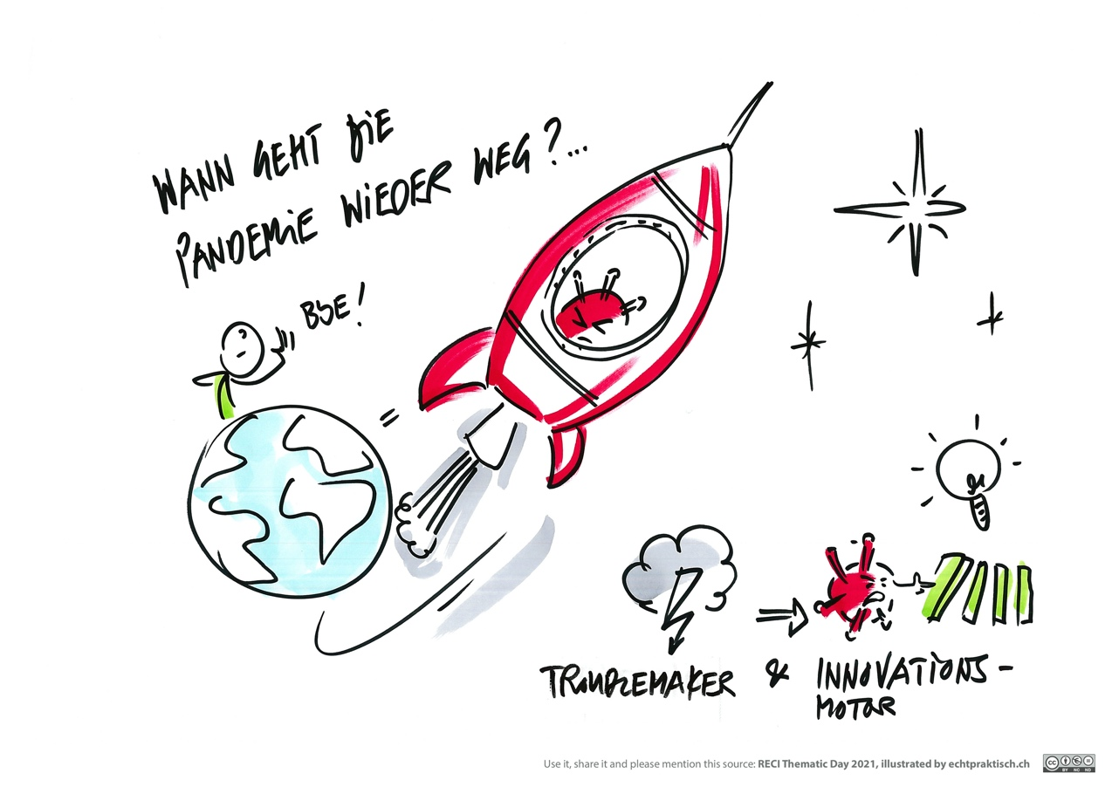
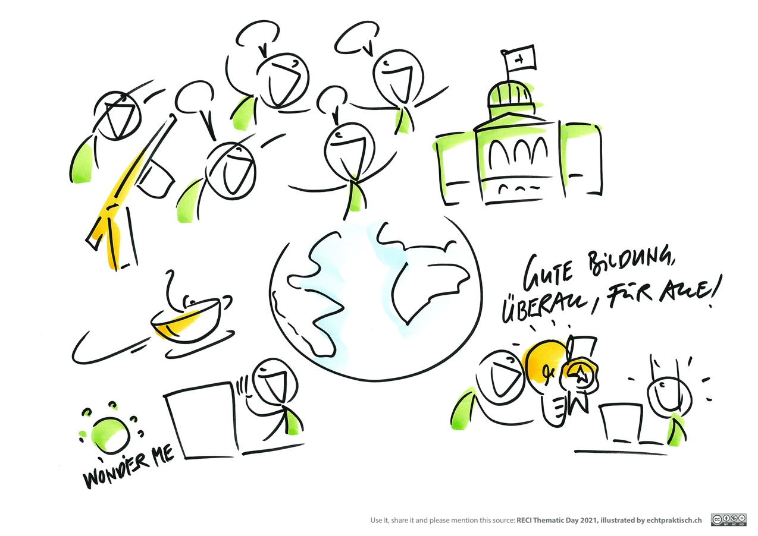

Slide 16
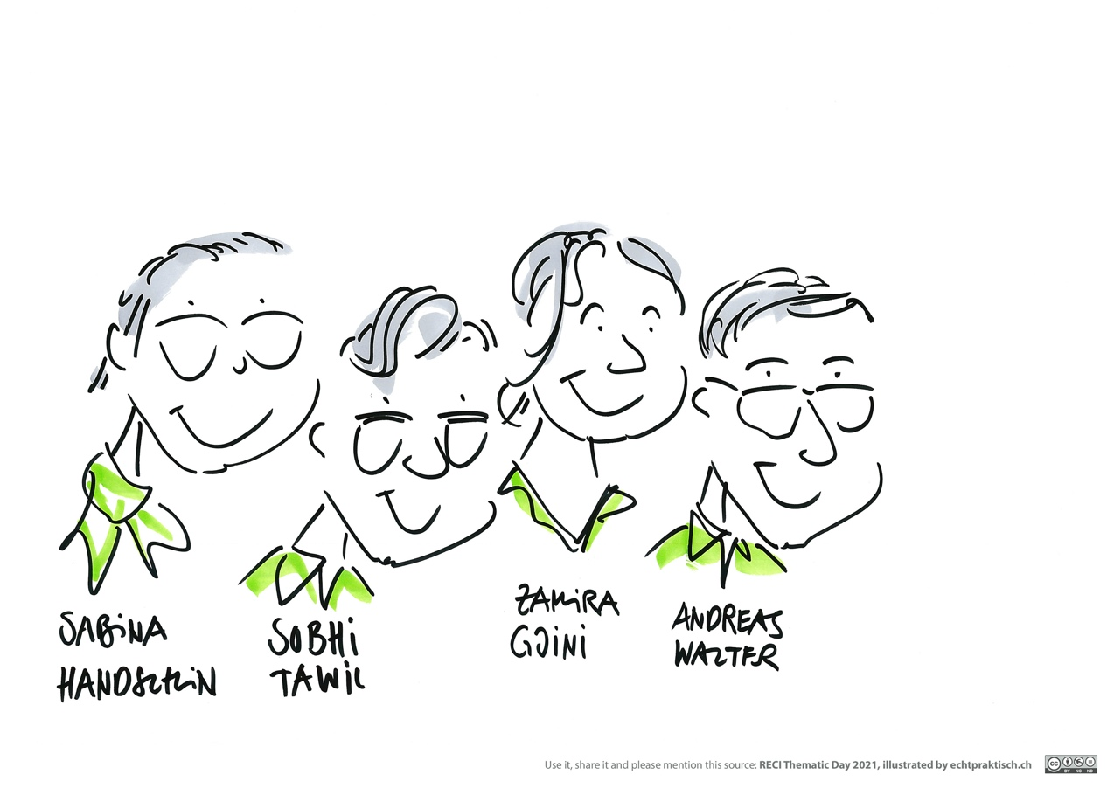
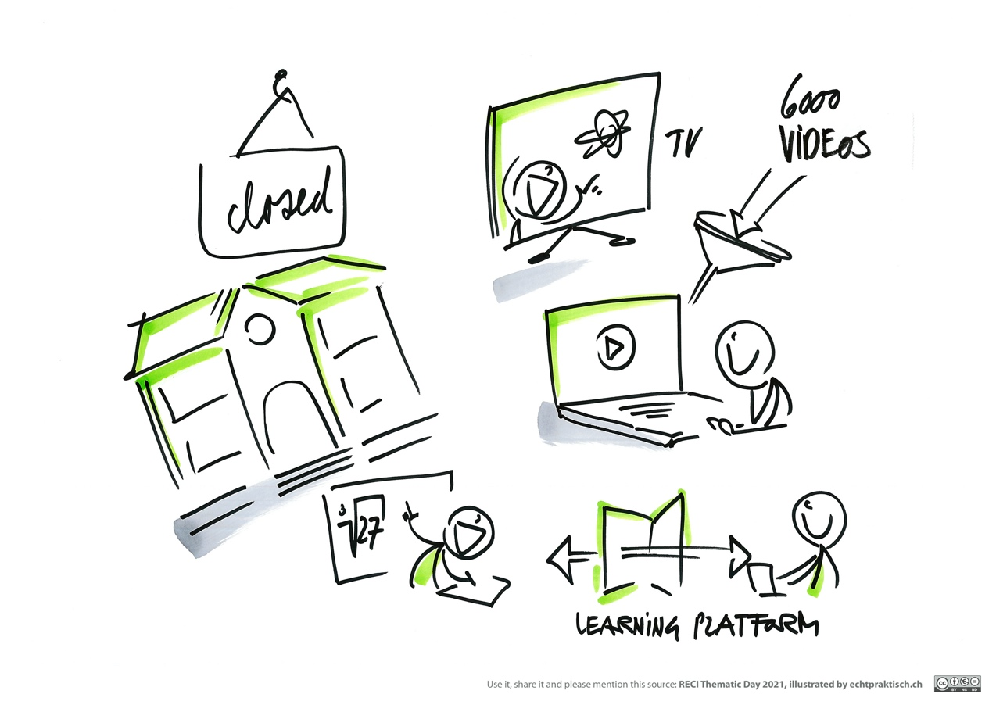

Slide 17
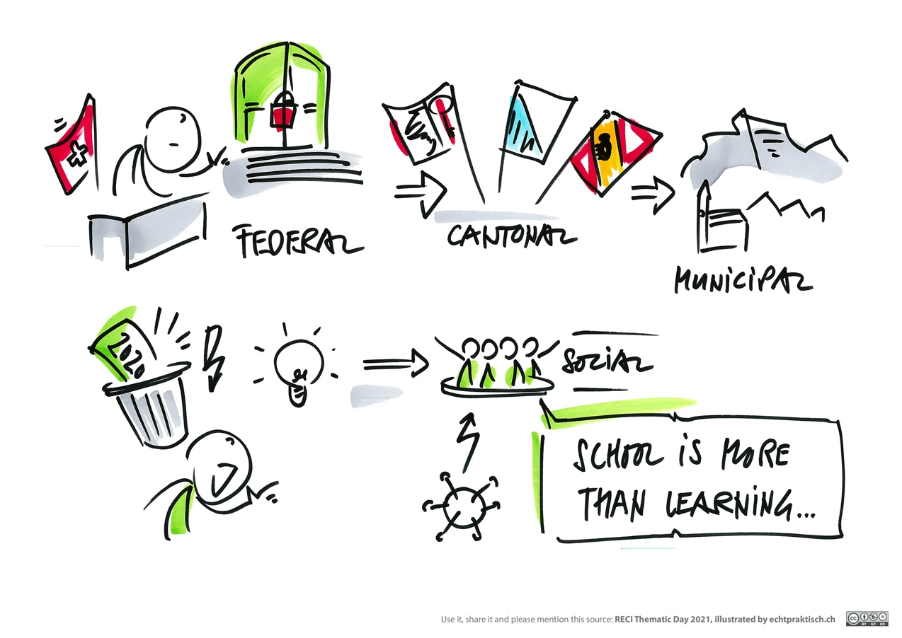
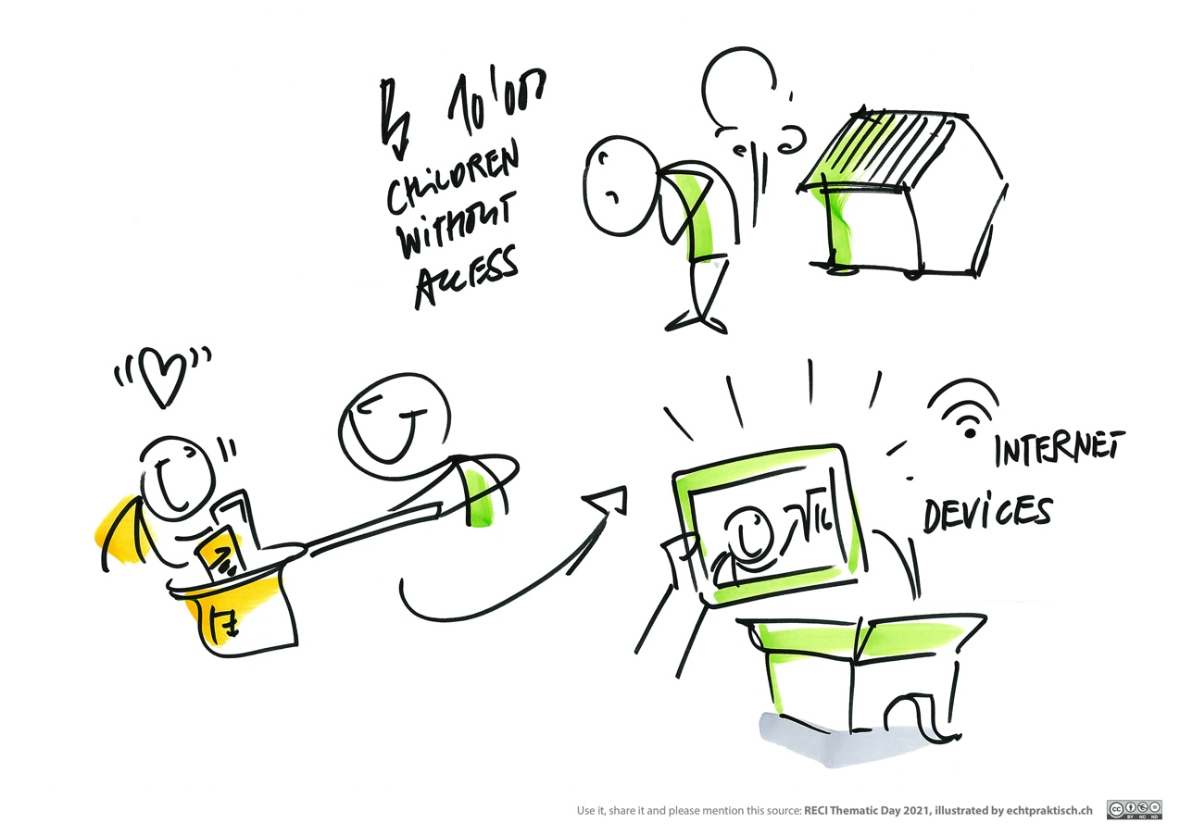

Slide 18
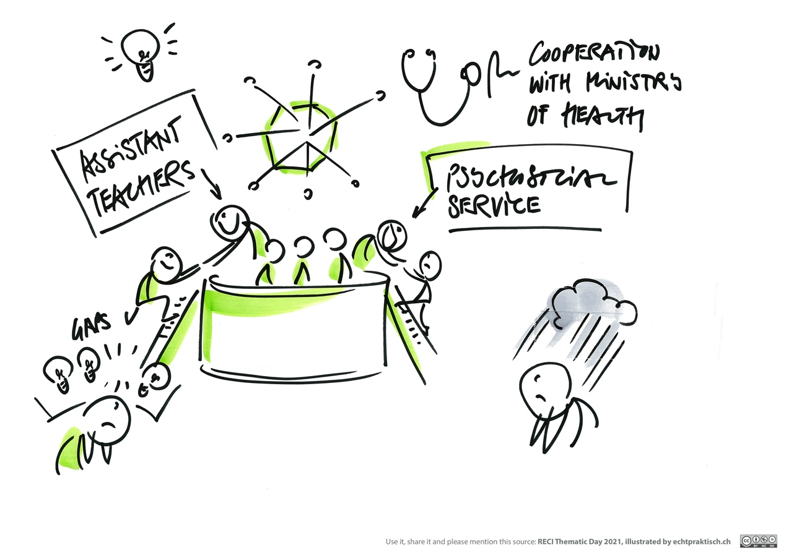
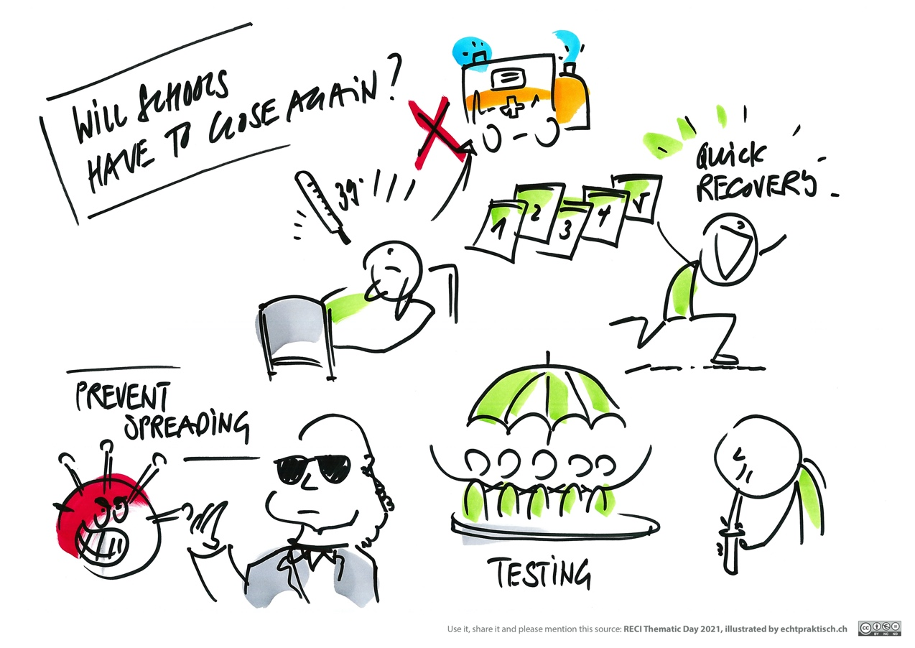

Slide 19
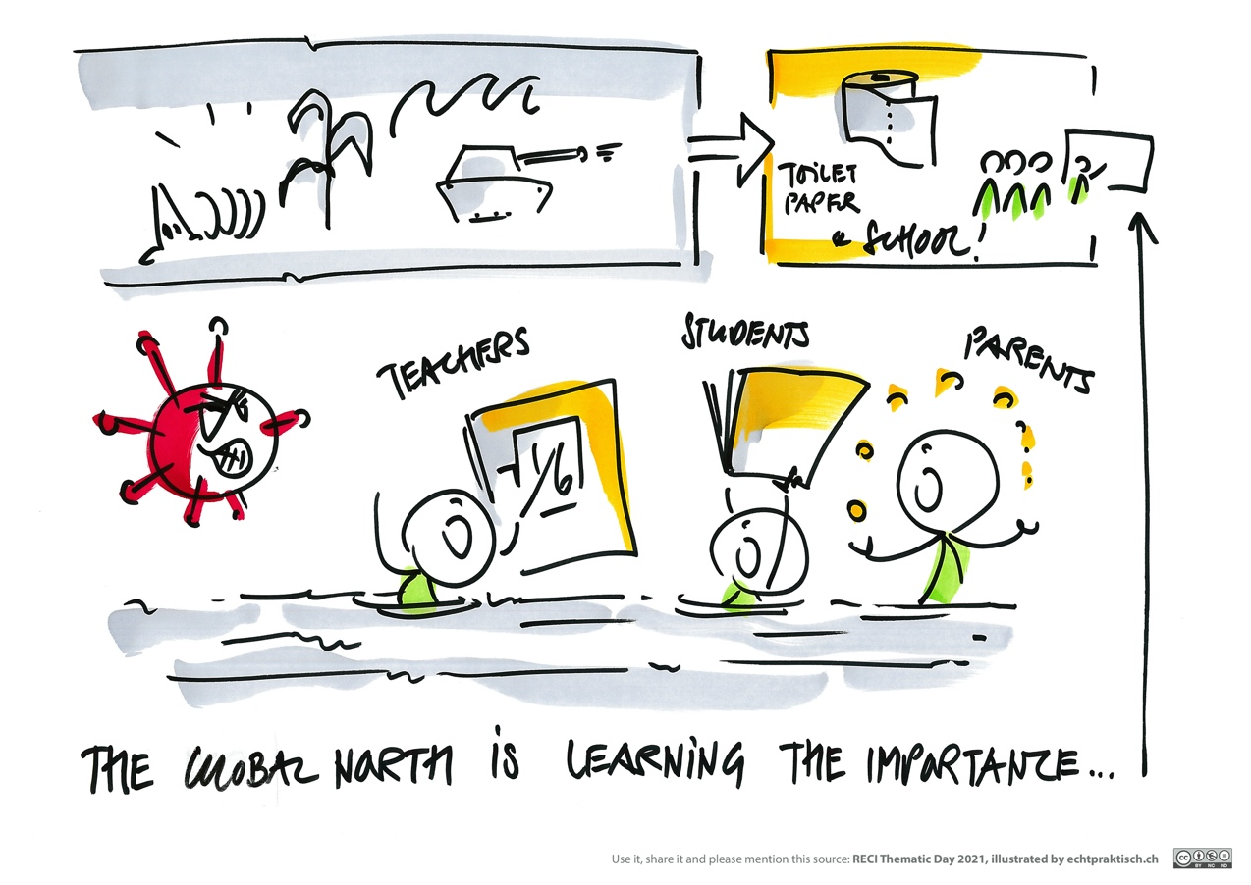
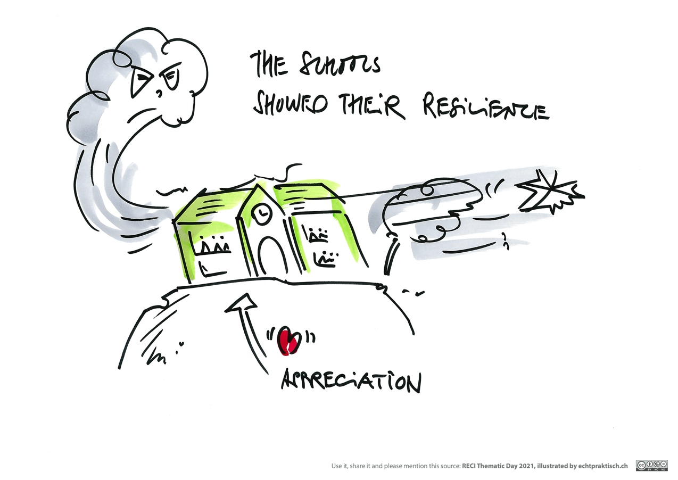

Slide 20
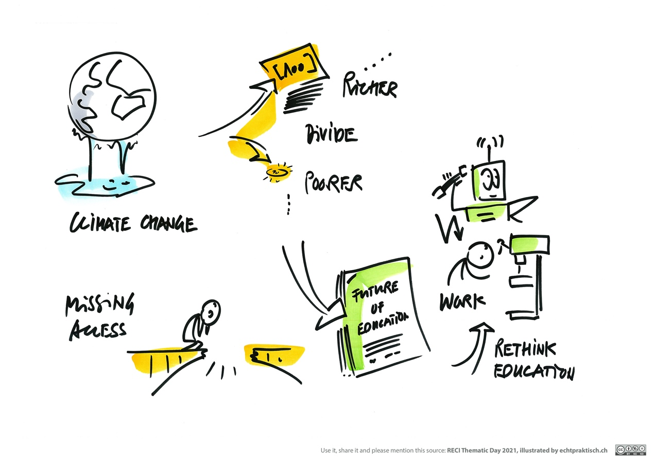
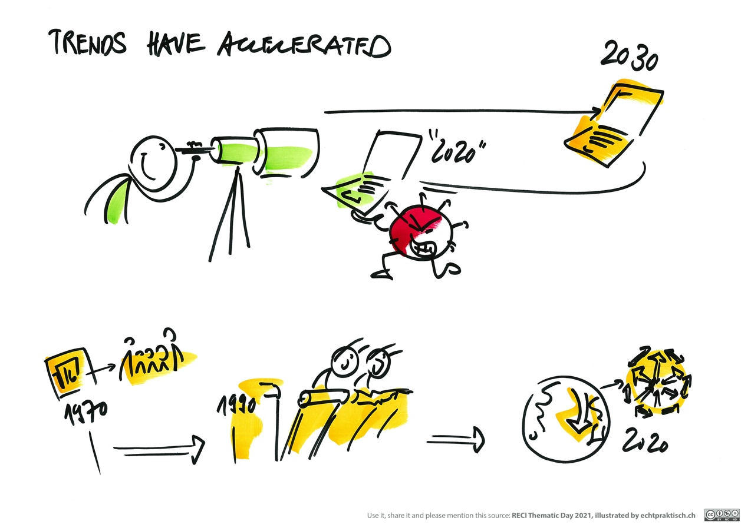

Slide 21
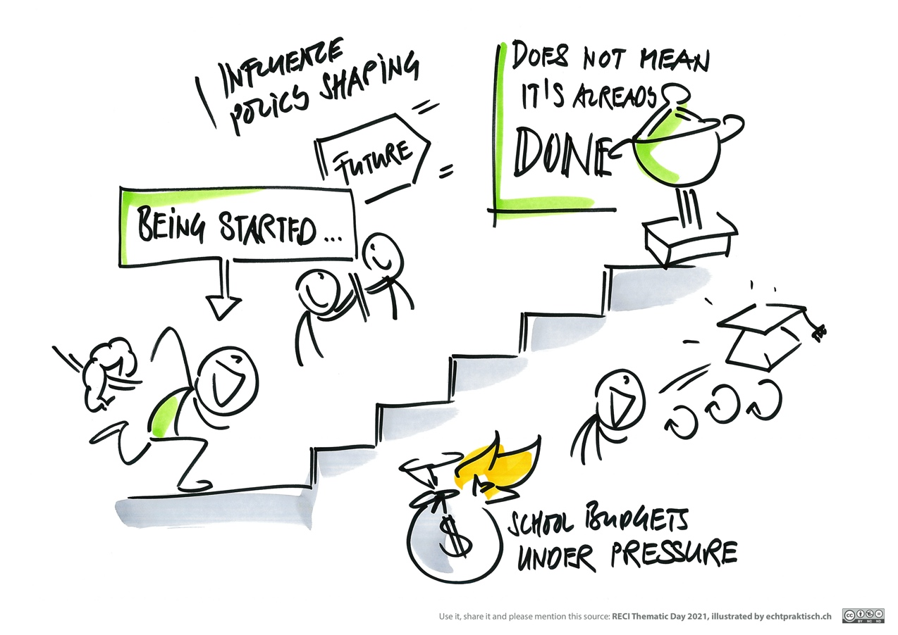
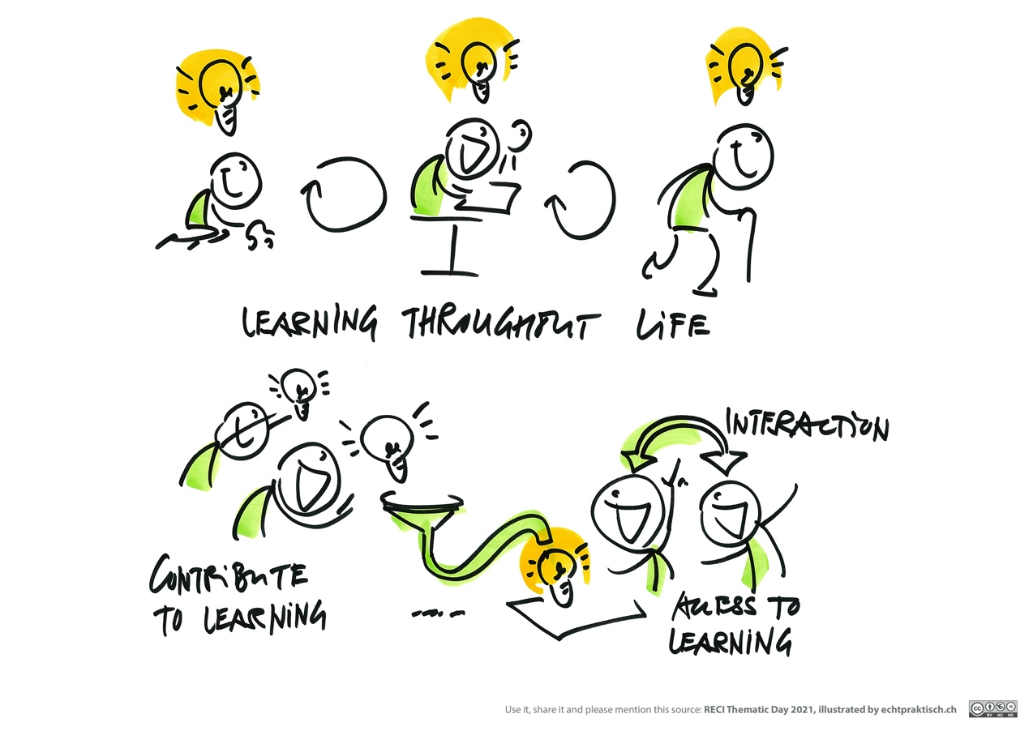

Slide 22
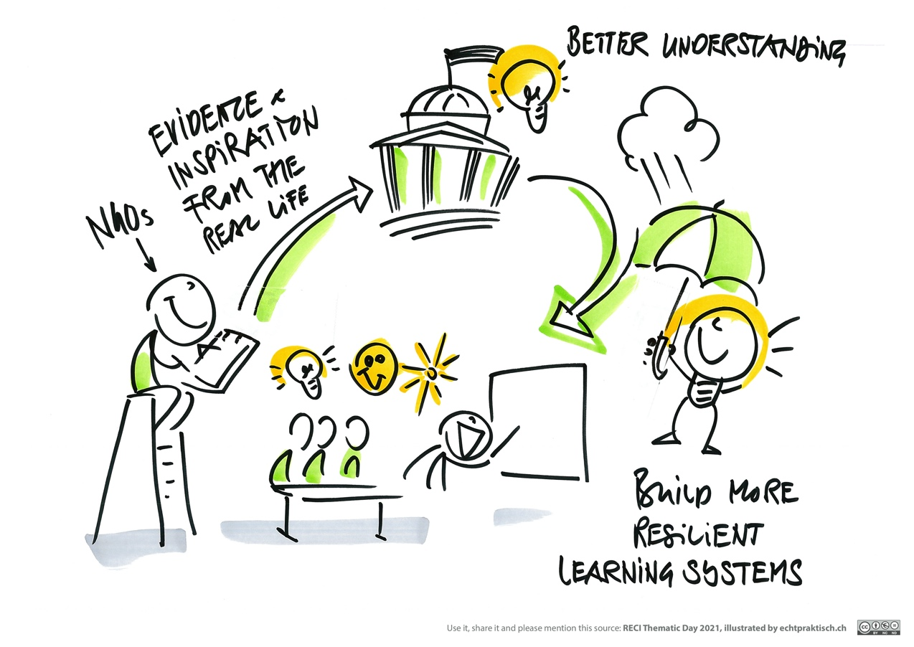
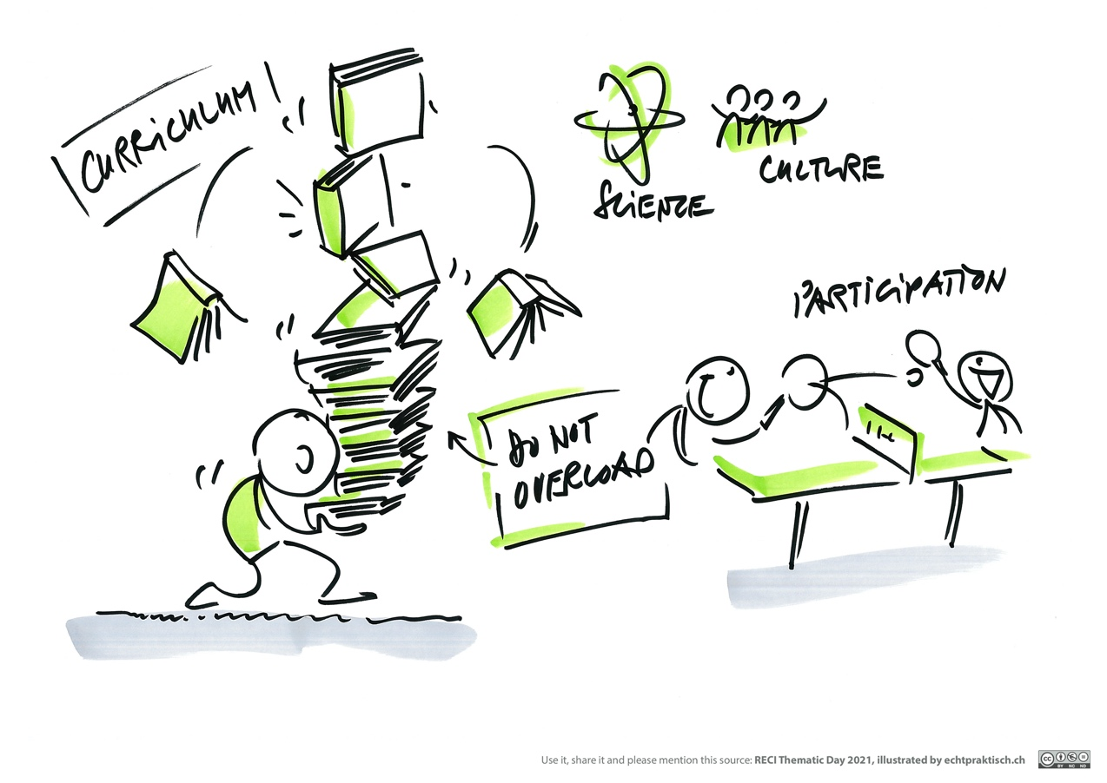

Slide 23
