Slide 1

The Education – Training – Work & Employment Continuum
For Socio Economic Integration: A Life Long Learning Perspective
Michel Carton
June 2019
Notes:
JUST PUT THE FULL LOGO (it includes the French name!!) + Page number
A LLL Perspective : on same line

Slide 2
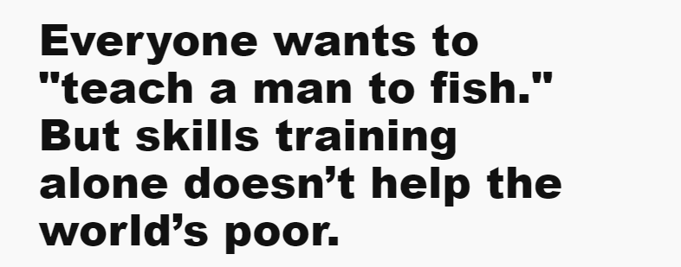
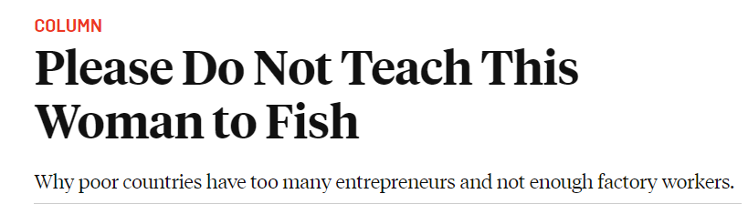
Notes:
THE LAST LINE SHOULD BE BIGGER, AS IT IS THE MESSAGE! What means Column?
Could we mention the bit.ly address underneath each quotation? People will have a paper copy of the PPT, so that they can find the full text?

Slide 3
Continuum: general definitons
Français
Ensemble dont les éléments sont inséparables, constituent un tout
Ensemble d’éléments tel que l’on puisse passer de l’un à l’autre de façon continue
English
Something that changes in character gradually, without any clear dividing point
A set of elements such that between any two of them there is a third element (Math)
Notes:
Sometimes the titles had all the first letters capitalized and sometimes not; to be consistent, I am only capitalizing the first letter; can easily be changed! OK!!

Slide 4
From the linear Continuum to a Dis-continuum
Once upon a time, the Education - Training – Work & Employment Continuum was ..........
a Continuum
= Linearity + sequential Temporality progressive socio-professional Integration + further mobility of individuals and groups in society
Today, E – T – W&E Continuum is ..........
a Dis–continuum (mirroring globalisation)
Notes:
Put in an arrow, instead of a >, please let me know if it work. OK!
OK POUR FLECHE, MAIS NE DOIT PAS COUVIR MOT

Slide 5
1
3
2
E
E
T
T
W
W
Notes:
I didn’t know if you wanted the numbers put in or if that was for my own instruction; can be easily taken out!
OK for numbering + Add in 1 : L (for Learning) T and W
Peut on mettre des flèches et les briser dans schéma 3?

Slide 6
Effects of socio-economic globalisation/societies and individuals
From open-ended to dual societies
From more or less articulated, to segmented societies
Increasing inequalities, between individuals, groups, countries..../ Access to public goods
Socio-professional exclusion
Notes:
FLECHE AU LIEU POINT DEVANT SOCIO-PROF

Slide 7
Effects of socio-economic globalisation on E, T, W&E
Changing values of Education and Work
Transformation of Education and Work
organisation and technology
From Education (Supply) to Learning (“Demand”)
From Technical and Vocational Education and Training to TV Skill Development
Changing roles of E, T, W&E for socio-professional Integration
Notes:
FLECHE DEVANT CHANGING ROLES

Slide 8
Consequences of socio-economic globalisation on the Continuum
Dis-continuities between/within sectors/“silos”:
Education: F, NF, Inf. (Youth/Adults; Rural/Urban; Public/Private…)
Training: F, NF, Inf. (Public/Private; Inside/Outside Schools/Enterprises; Dual…)
Work & Employment: (“Inf.”/“Modern” sectors; Job/Employment…)
Scaterred Governance arrangements
Notes:
FLECHE DEVANT SCATERRED

Slide 9
Are dis-continuities impacting everyone’s socio-professional integration the same?
Educated, well-off self-organised public/private solutions to by-pass dis-continuities
Middle classes under social and financial threats difficult scaling up via E/T
Excluded/marginalised youth and adults: out of school, drop out youth; youth without VT /employment opportunities; unemployed graduates; youth and adults without basic education:
no individual solutions public policies to be developed
Notes:
FLECHES COUVRENT MOTS?

Slide 10
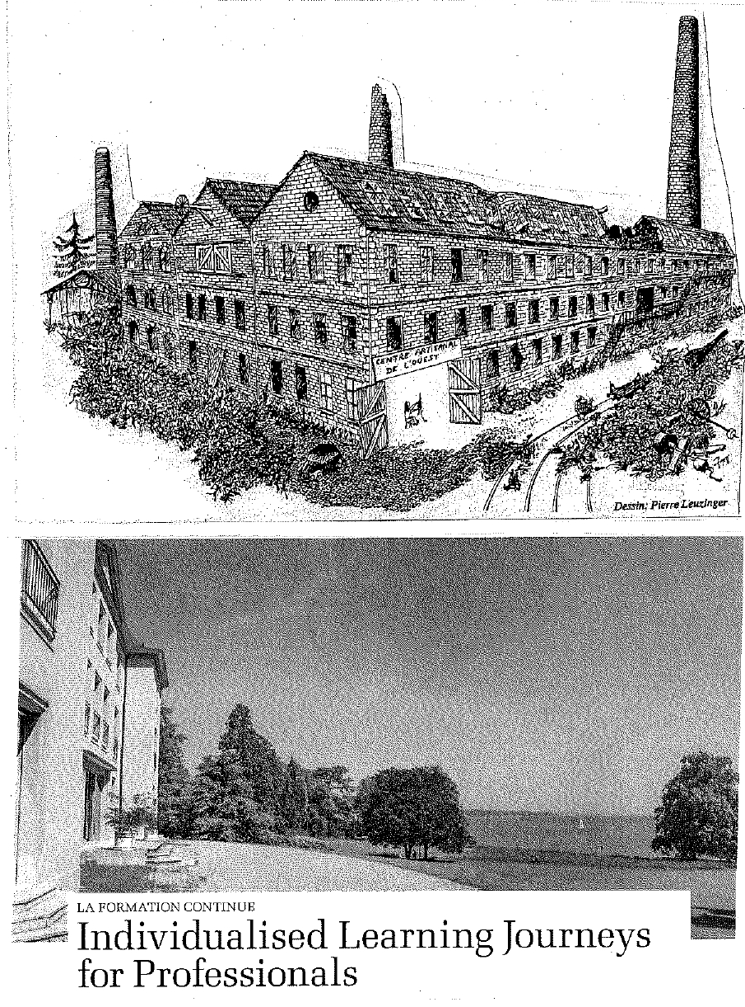

Slide 11
How to rebuilt a New Continuum for the future?
Overpassing discontinuities is not back to “good old days” temporalities and linearities !
Open access to integrated E, T , W & E system
Possibility “travelling” through any field New Continuum, any time and order, thanks systemic non-linear connectivities
Possibility to acquire values, skills and knowledge proposed by public + private stakeholders connected in New Continuum
Notes:
FAUT-IL CENTRER LES 2èME LIGNES DES TITRES ‘ (DEPUIS DéBUT)
FLECHE DEVANT 2èME POSSIBILITY

Slide 12
Conditions and priorities for efficiency and impact
“De siloized” = systemic governance arrangements
Capabilities acquired during “journey” recognized by governance stakeholders, after “stop overs” any field of the New Continuum.
Public policies TBD (administration, local authorities, PPP…..) for securing access public goods
New Continuum = value for any social category, but priority on the Marginalized

Slide 13
New Continuum interplay with L L L: a second chance for both ?
Continuum “out dated”, not reflecting
Education and Work futures (ILO, WB…)
LLL: no agreement / definition ( UIL, 2016), any coherent implementation strategy, divergent notions of learning…
Cross recognition system of E, T and W&E based knowledge and skills = concretization 2 notions
Focus Marginalized categories, under further exclusion threats + a socio-eco loss for societies attracting policy makers
Notes:
. FLECHE 3èEME PARA AVANT CROSS
FlECHE 4EéE PARA DEVANT ATTRACTING (en 3ème ligne))

Slide 14
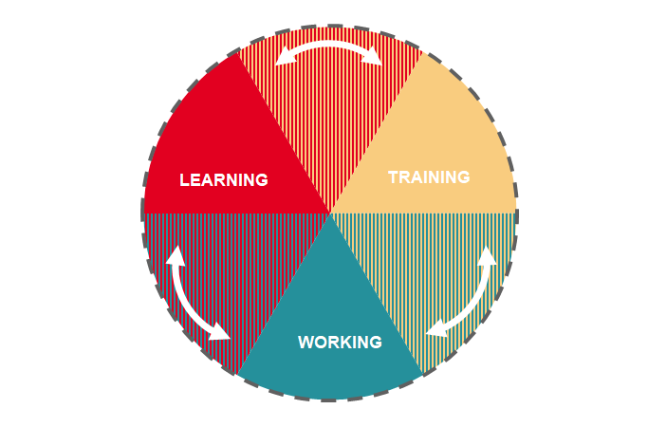
“New” Continuum: life long learning for youth and adults?
Notes:
Slide 14 devient 13

Slide 15
